Slide 1
Evaluating Administered Differences of Brief Jail Mental Health Screener and Impacts of Diagnoses & Treatment of Linked Inmates with Serious Mental Illness
Jefferson Area CCJB Meeting
April 13th, 2022
George Corbin, Nora Dale, Aatmika Deshpande, Katherine Korngiebel, Paige Krablin, Emma Wilt

Slide 2
Capstone Team
George Corbin
Systems Engineering;
Data Science Minor
Nora Dale
Systems Engineering;
Urban Planning Minor
Aatmika Deshpande
Systems Engineering & Economics;
Data Science Minor
Katherine Korngiebel
Systems Engineering & Math
Paige Krablin
Systems Engineering;
Engineering Business Minor
Emma Wilt
Systems Engineering
Notes:
Introduce team, point out diverse areas of study from DS to Business to Math to planning

Slide 3
1.
Past Work &
Current Goals
Notes:
Note that we’re the 5th iteration of the project

Slide 4
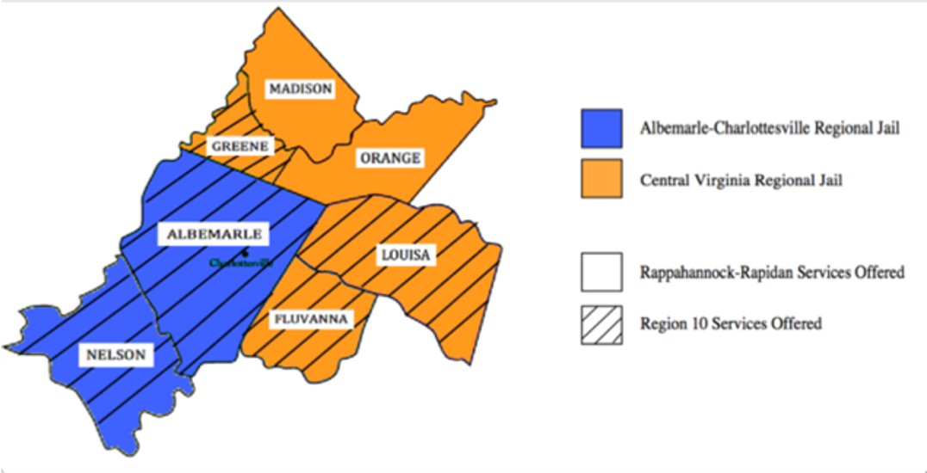
Past work focused on matching; our goal was to deep dive into the screener and matched populations
36.4% of ACRJ inmates and 16.9% of CVRJ inmates who were administered the Brief Jail Mental Health Screener met the screening criteria for serious mental illness (2015-2021)
Past research focused on investigating who gets screened in and matched* to treatment:
(2020) Individuals matched to Region 10 return to ACRJ custody at higher rates than those not matched
(2019) 61% of individuals who did not screen-in received services from Region 10 (type of service not specified)
(2018) Matched Individuals had a higher average number of visits for every Region 10 service except Substance Abuse compared to those not matched
(2017) Matched individuals are less likely to successfully complete the OAR Local Probation
Our goal: investigate the differences in BJMHS screener results and diagnoses between groups who (1) screened in, (2) screened out, and (3) matched* to understand what is driving the results above
*Def: individual found in both ACRJ & R10 dataset
Notes:
Point out how past years have focused on R10 and its applications to inmates. Further define matched, demographics and characteristics of matched individuals.

Slide 5
2.
Brief Jail Mental Health Screener (BJMHS) Background

Slide 6
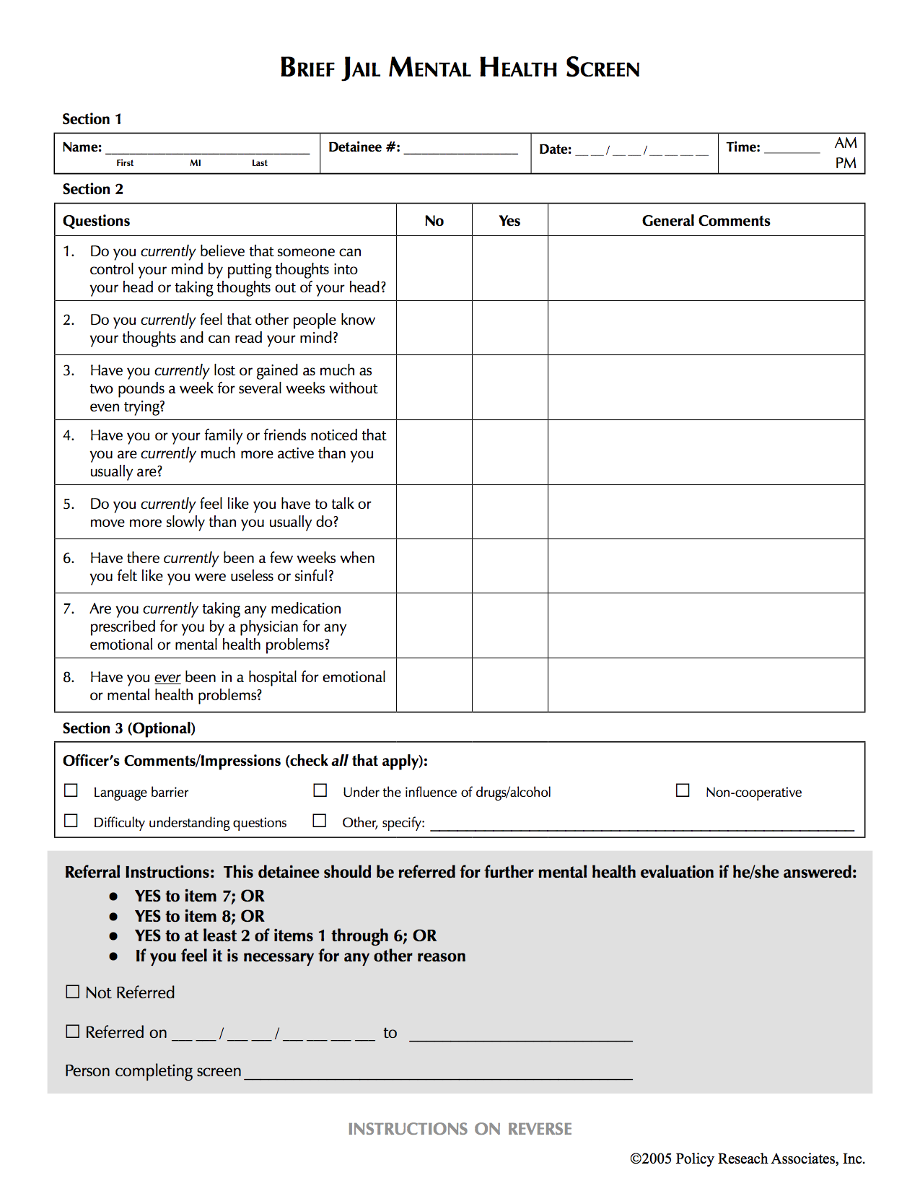
The BJMHS helps identify possible serious mental illness in inmates, but is administered differently within the region
8 Question screener is the first step to identify possible serious mental illness in inmates
Intended to be given to all inmates, and those ‘screened-in’ are referred to additional mental health services
Differences in screener administration:
At CVRJ, screener is given as part of larger questionnaire by officer at booking
At ACRJ, screener is given between 24 and 48 hours after booking by a nurse
Discretionary referral option available
Notes:
Go over the process and the screener. Show signs of severe mental illness. Referred for further mental health evaluation and potentail treatment

Slide 7
10,507 Total Individuals in ACRJ
13,274 Total Individuals in CVRJ
7,132 Screened
13,274 Screened
2,598 Screened-In
2,241 Screened-In
Oct 2015- Dec 2021
Jan 2013- June 2021
With the BJMHS
With the BJMHS
36.42% Screen-In Rate
16.88% Screen-In Rate

Slide 8
There are 2 sets of questions in the BJMHS: Diagnostic (Q1-Q6) and Therapeutic (Q7-Q8)
Diagnostic
Meant to identify possible symptoms of severe mental illness
Therapeutic
Meant to identify either current mental health treatment or previous hospitalization
Notes:
Explain the difference between diagnostic and therapeutic. 2 questions a piece for illness (major depression, bipolar, schitzophrenia) for diagnostic

Slide 9
There are 4 main paths/populations; Screened-In was split by reason
Diagnostic Factors:
>=2 Yes for Q1-Q6
Therapeutic Factors:
>=1 Yes for Q7-Q8
Screened-In
Matched
Def: individual found in both jail & R10 dataset
Booked
Screened-Out
Not Matched
Booked → Screened-In (Diagnostic and/or Therapeutic) → Matched
Booked → Screened-In (Diagnostic and/or Therapeutic) → Not Matched
Booked → Screened-Out (Diagnostic and/or Therapeutic) → Matched
Booked → Screened-Out (Diagnostic and/or Therapeutic) → Not Matched
Jail (ACRJ/CVRJ)
Therapeutic Services (R10)
Notes:
Explain path the populations take. Are there any questions about the screening process or the categorization of screened in populations. Express limitations in matched and screened populations because of data ranges.

Slide 10
3.
Findings for ACRJ & CVRJ and the BJMHS
Notes:
Explain the difference between the data sets we used, cutting out those that spent less than 2 days in custody at CVRJ

Slide 11
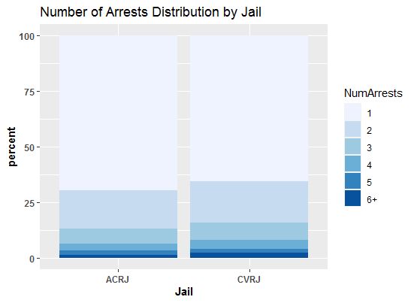
There is virtually no difference between the distribution of the number of current and previous arrests between the jails
The return-to-custody rate of the general inmate population is the same at both ACRJ and CVRJ.
Notes:
State that the distribution of number of arrests in jail inmates is very similar, explain why this is important for later findings

Slide 12
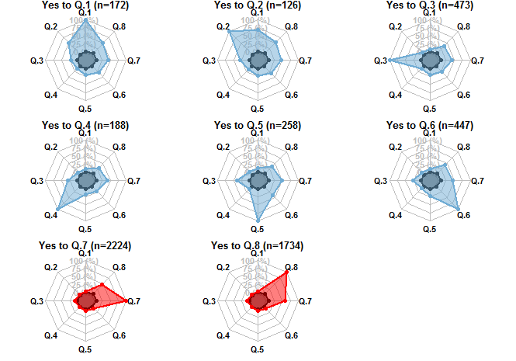
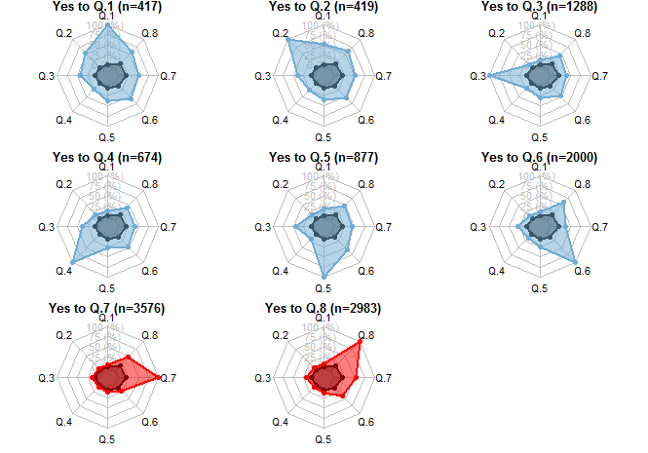
Both jails show similar correlations among “yes” responses to certain questions; Q7 and Q8 are highly correlated
CVRJ
ACRJ
When an individual answers yes to a therapeutic question, they are no more likely to respond ‘yes’ to a diagnostic question than the general jail population. Some pairs of diagnostic questions, such as 1 and 2, are often answered ‘yes’ together.
Notes:
Note how questions 1 and 2 are both for schizophrenia,

Slide 13
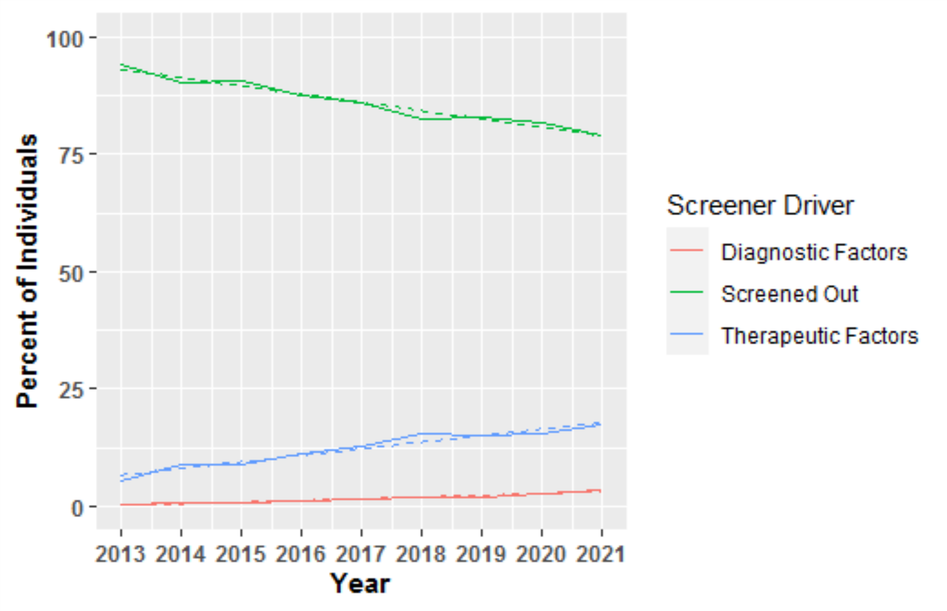
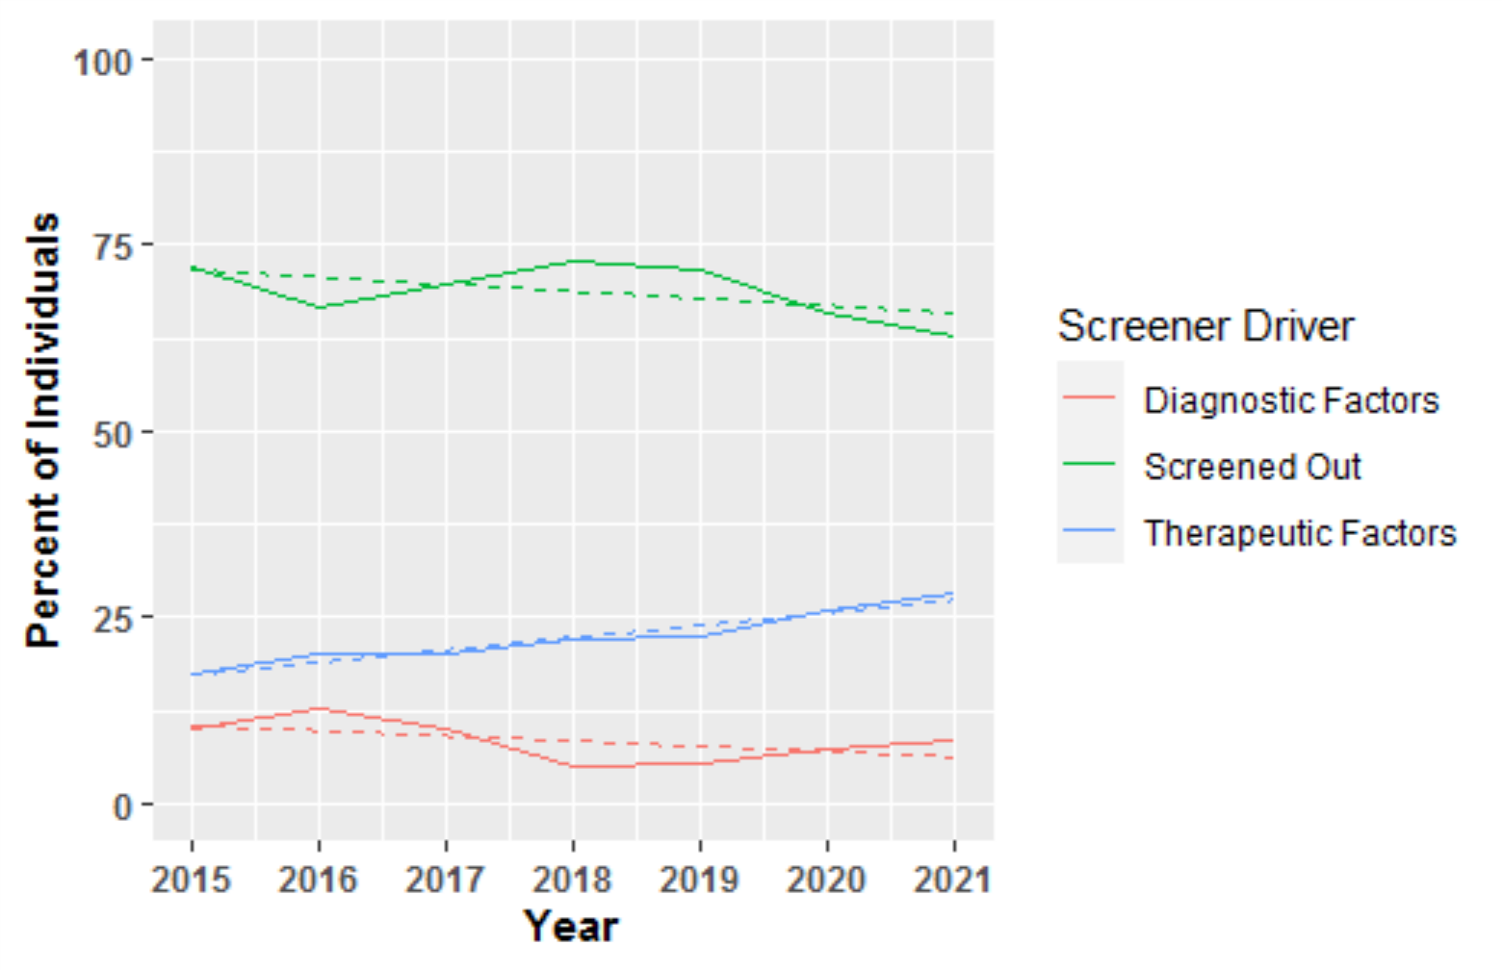
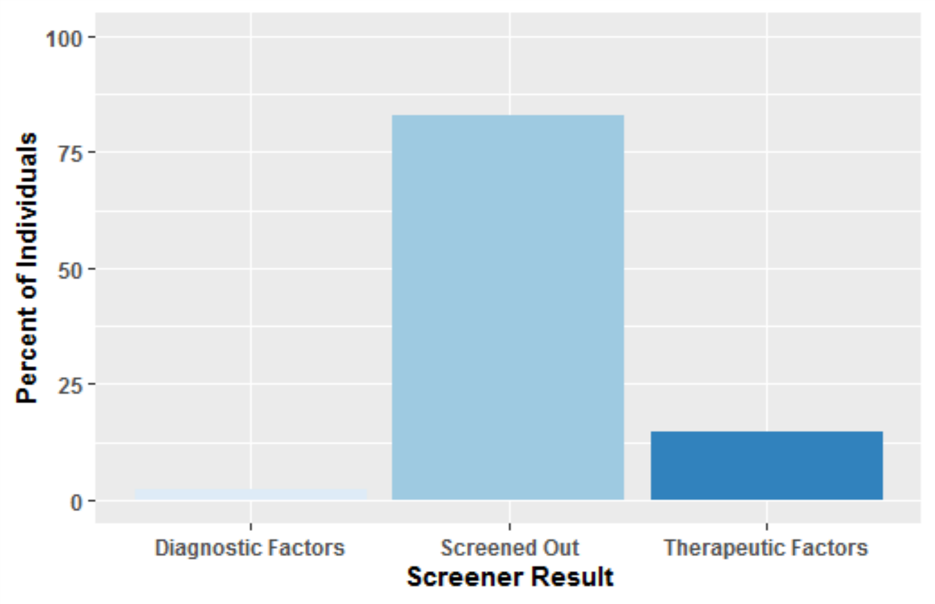
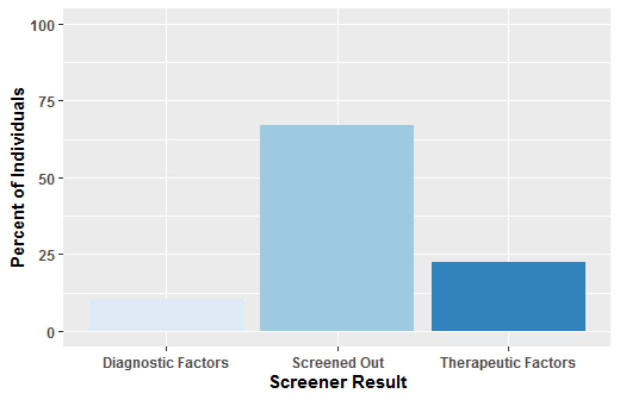
Overall screener trends are similar but CVRJ’s group differences are more pronounced
CVRJ
ACRJ
n=8462*
n=5130*
*number of unique individuals in data
Over the years, more inmates are screening in; therapeutic factors account for the majority of these.
Notes:
In the last 10 years, CVRJ has received a larger amount of change in screen in rates than acrj

Slide 14
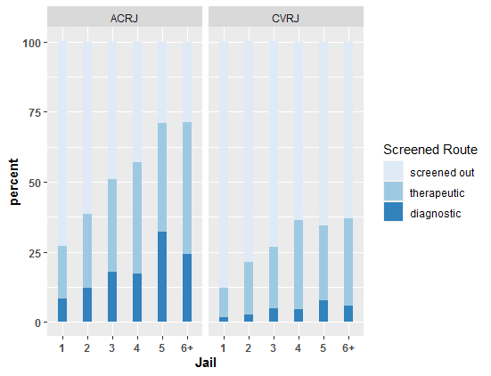
The percent of people screening in increases with the number of arrests for both jails
As number of arrests of an individual increases, the rate of screening in by therapeutic factors and by diagnostic factors increases. The increase is more consistent for therapeutic factors, which may indicate individuals with more prior arrests are more likely to have received treatment, either currently or in the past.
Notes:
We can again see that the screen-in rates at ACRJ and CVRJ, even when controlling for jail times, is different
At both jails, we see screen in by either method increasing as number of arrests increases, and that therapeutic seems to increase at a more consistent rate at both jails.

Slide 15
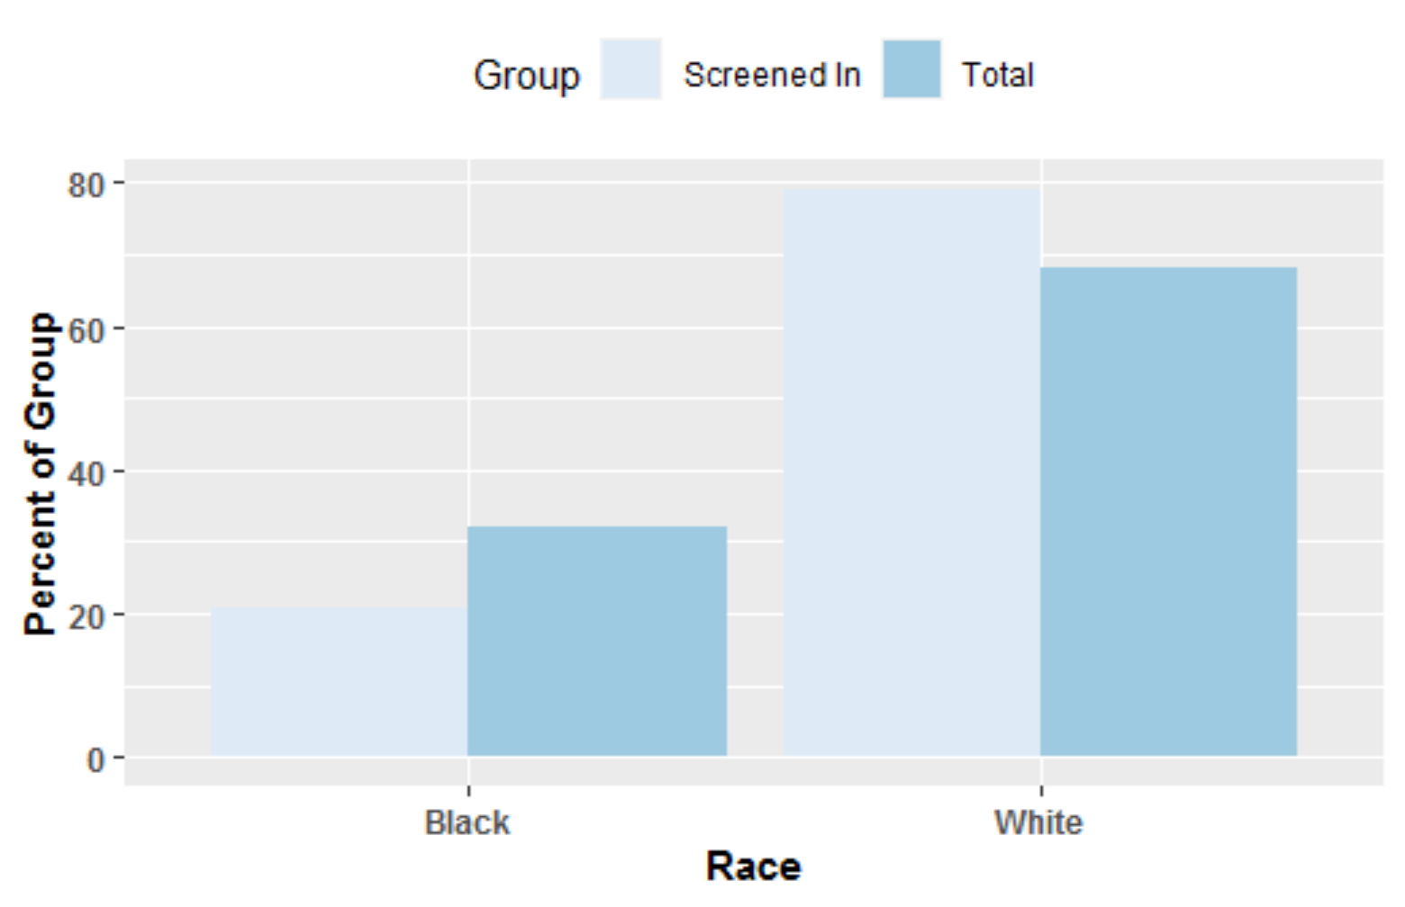
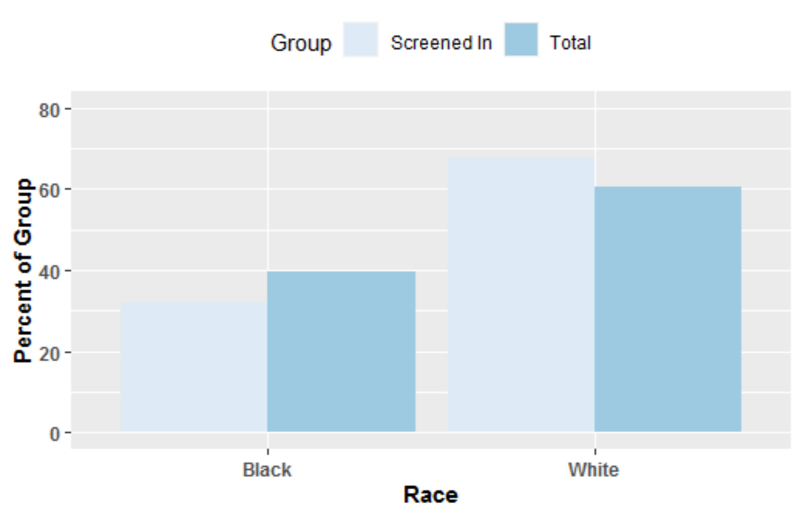
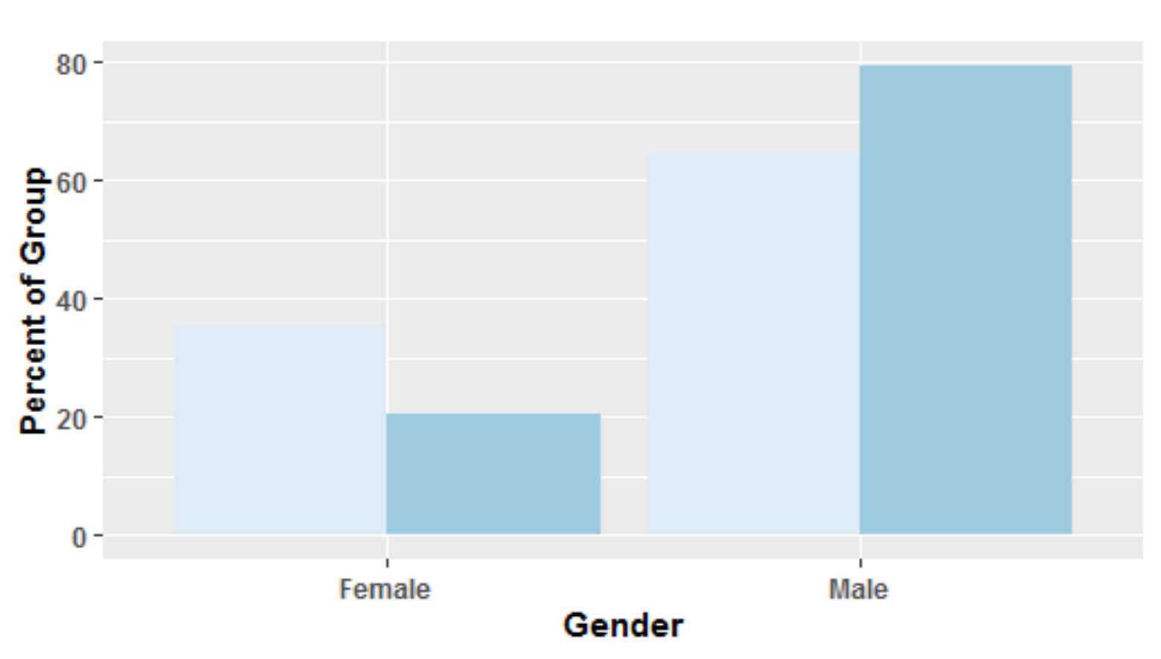
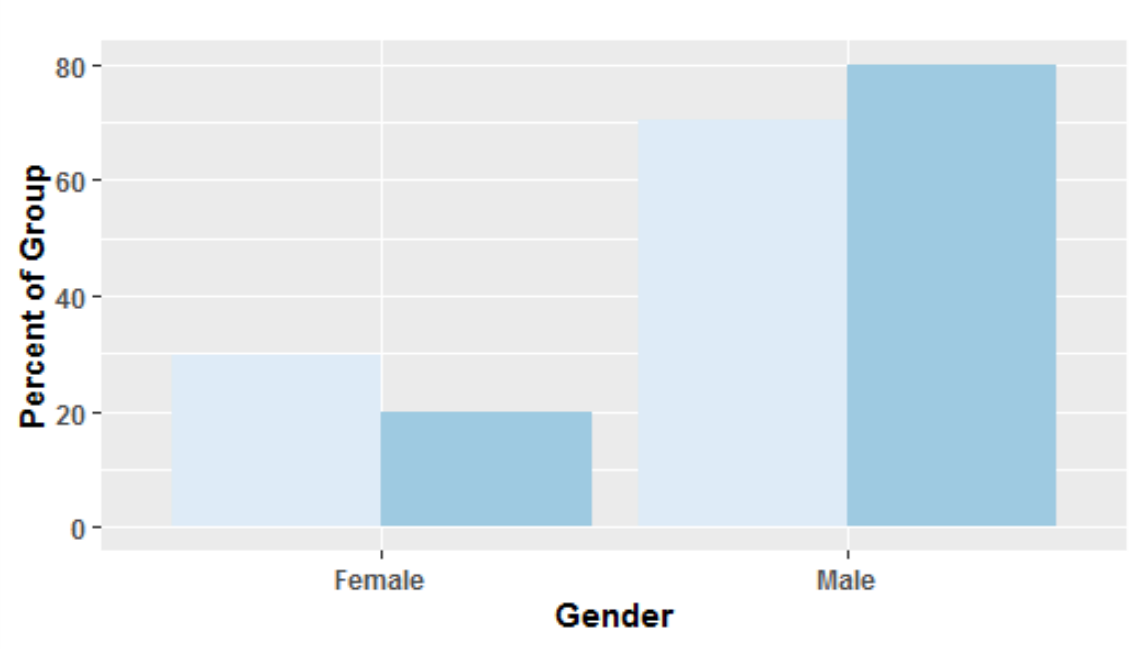
Jail compositions are similar and national screener trends are reflected for both race and gender
CVRJ
ACRJ
ACRJ has a closer balance between Black and White inmates, while the female to male ratio is virtually the same. Females account for a larger portion of the Screened-In group than expected, Black inmates account for a smaller portion. Nationally, women screen in at a higher rate, and Black individuals screen in at a lower rate.
Notes:
Jail demographics with regard to gender are similar, while CVRJ has a higher proportion of white inmates than ACRJ
Black inmates screen in at lower rates than white inmates, which agrees with national screener trends
Women screen in at higher rates than men, which is at in agreement with national trends

Slide 16
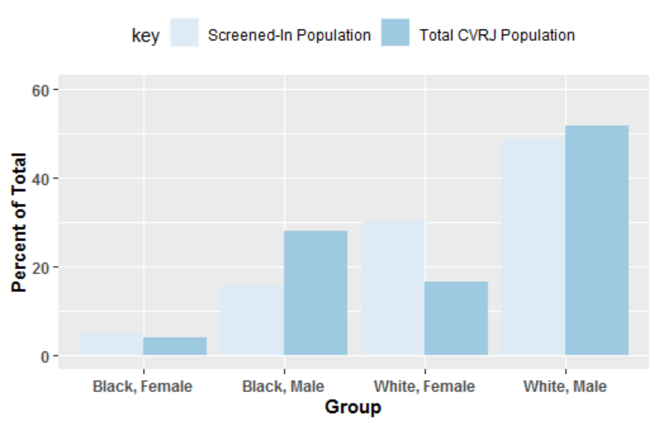
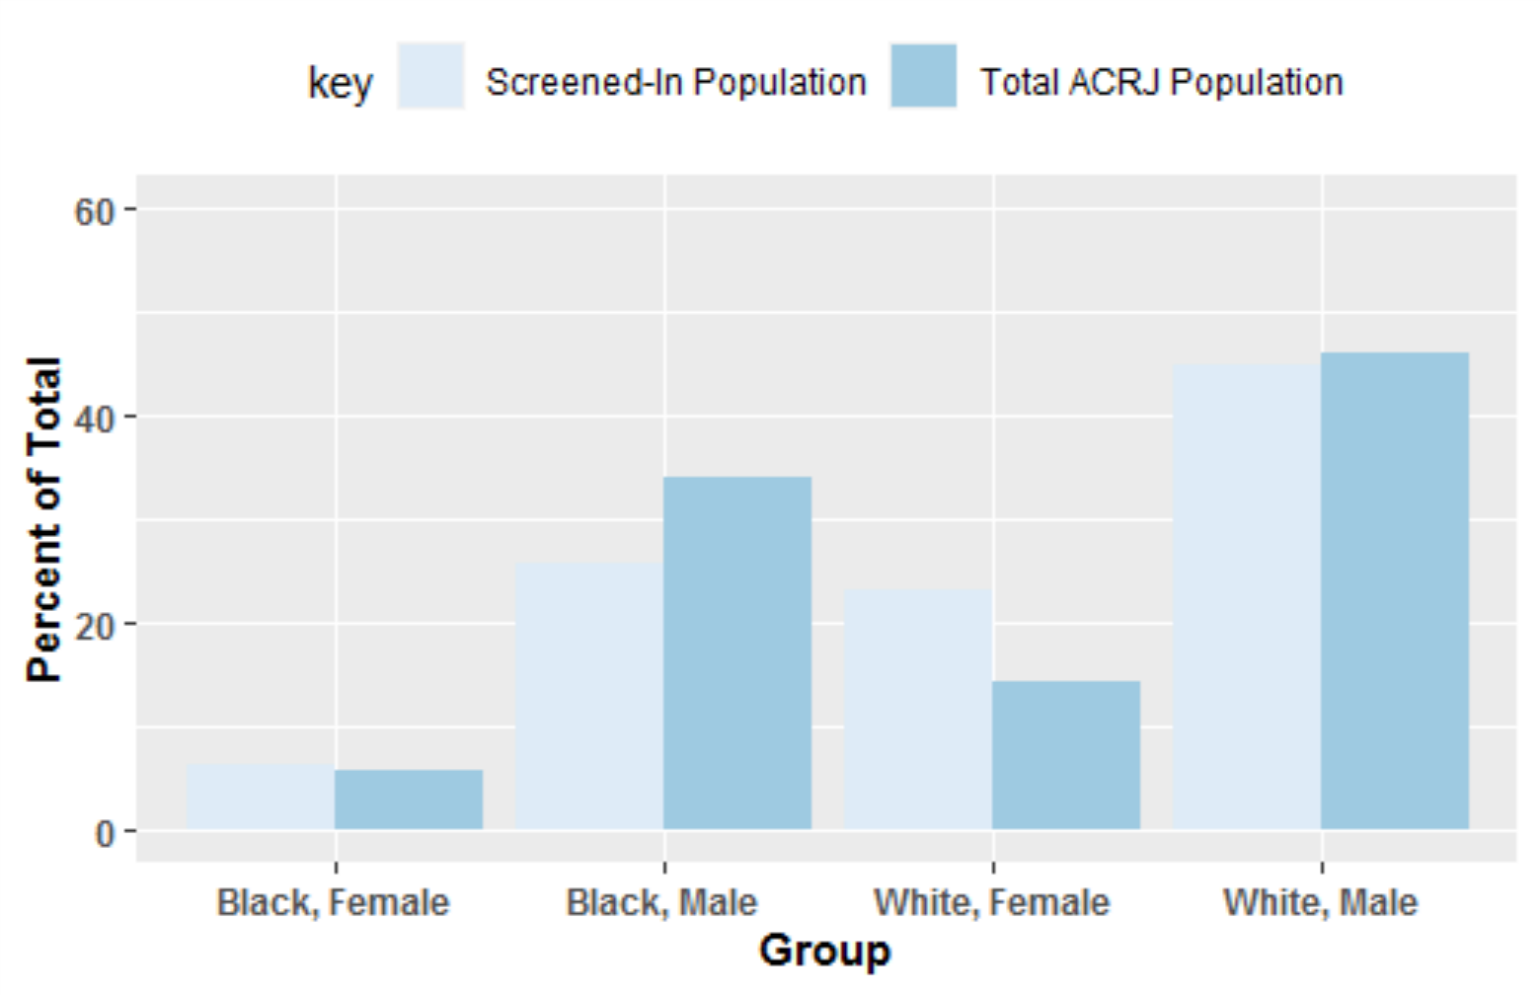
Accounting for both gender and race reveals jail similarities and disproportions in “Black, Male” & “White, Female”
CVRJ
ACRJ
Comparatively, ACRJ has a larger total population of the latter. Black female and White male proportions in the screened-in population were as expected. However, Black males accounted for a smaller portion than expected, and White females a larger one. Compounding effects from prior are shown.
Notes:
When looking at sex and race together, we again see similar trends in demographic screen-in rates at ACRJ and at CVRJ. We can also see that there may be more weight to sex than race in screen-in rates, as both Black and White women screen in at greater rates than expected and Black and White males screen in at lower rates than expected

Slide 17
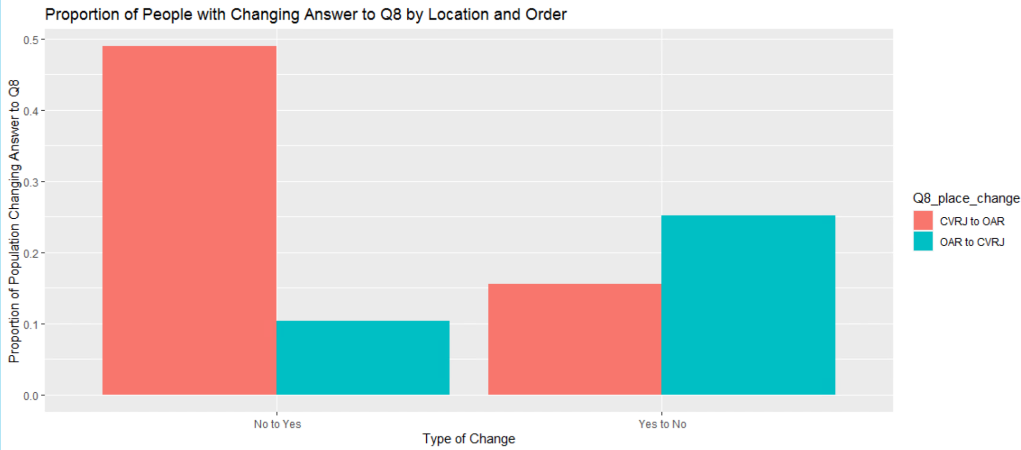
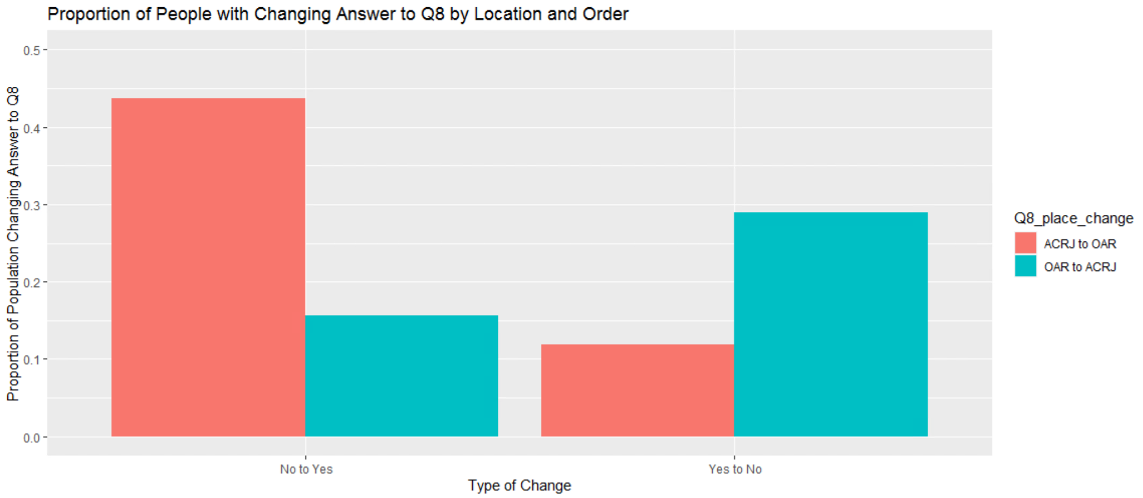
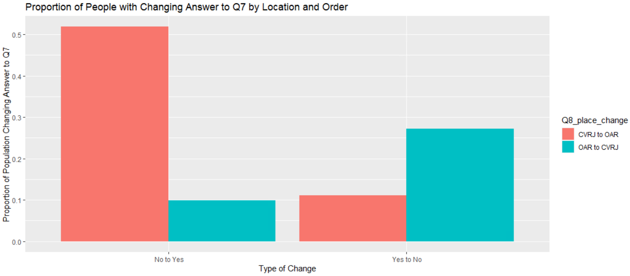
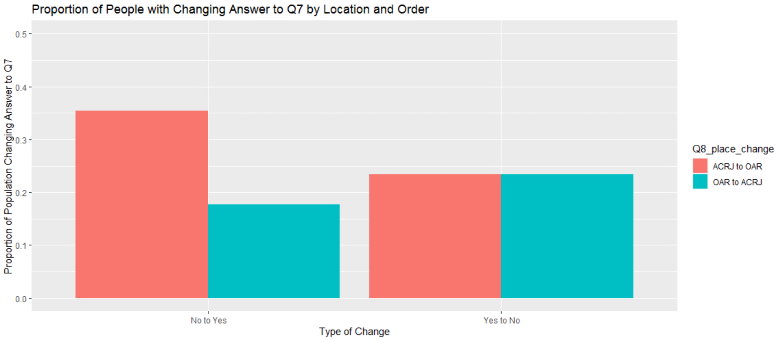
Location of screener administration has an effect on the way inmates answer Q7 & Q8
Q7 Place Change
Q7 Place Change
Individuals changing their answers to questions on the BJMHS are more likely to acknowledge past or current symptoms or therapies at OAR than they are at either jail.
Notes:
Get assistance from Nora
Of those who change their answer to questions on the screener (here we show q7 and q8) those that are acknowledging symptoms are more likely to be coming from a jail and going to oar. Inverse is also true
Acknowledge
We need to do further research to know why this is but one possible explanation is difference in administration of screener

Slide 18
3.
Findings for ACRJ & R10
Notes:
Reiterate that the next couple plots are only ACRJ data.

Slide 19
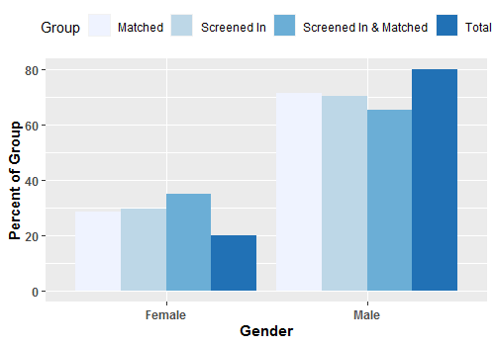
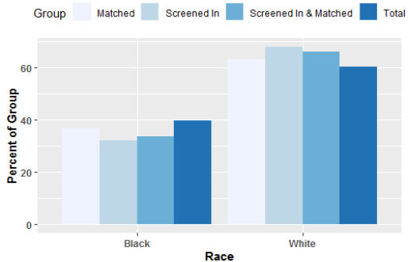
Female proportions are larger than expected; matching is not impacted by race, but screening in and matching is
Gender
Race
Females make up a significantly higher portion of all groups as compared to the total ACRJ jail population. Race does not impact expected match proportion, but when factoring in Screener results, it decreases.
Notes:
Limited window

Slide 20
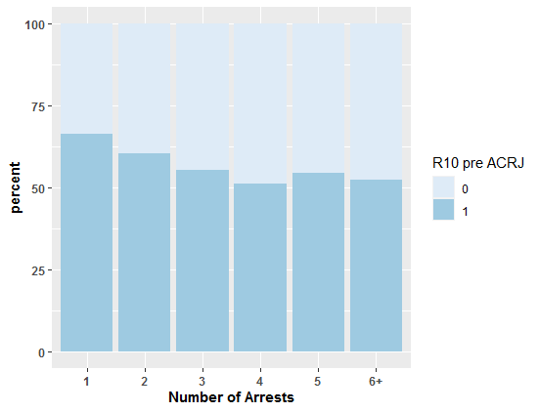
A matched inmate having a greater number of arrests do not correspond to a higher likelihood of receiving R10 treatment prior to the first arrest
*
*R10 pre ACRJ refers to an individual whose first date of service in the R10 database occurs prior to their first arrest in the ACRJ database
The percentage of individuals whose first arrest was before their first R10 service stays relatively constant as the number of arrests increases.
Notes:
High proportion of people have already received r10 service prior to their first appearance in the jail. Note the

Slide 21
4.
Conclusions

Slide 22
Conclusions
Individuals are more likely to screen in due to therapeutic factors than diagnostic factors
There is a positive correlation between the number of arrests and the proportion of screened-in individuals
White females are overrepresented in the screened-in group, Black males are underrepresented
The location where the screener was taken has an impact on the response to questions 7 and 8 on the BJMHS
A large proportion of the individuals screening in have received or are receiving mental health treatment

