Slide 1
A Framework for Pretrial Justice
Essential elements of an effective pretrial justice system and pretrial services agency

Slide 2
Getting Bail
Right.
Notes:
American courts process millions of criminal cases a year. Each requires a judicial officer to determine if a defendant should be released or detained pending trial. This is one of the most important decisions in criminal case processing, however, most judicial officers do not have the information nor appropriate release and detention options available to make the best bail decision. Moreover, most systems lack the structure needed to monitor released defendants, screen detained defendants regularly for release eligibility, and safeguard individual rights and community safety.

Slide 3
BAIL:
DEFINITION:
Requirements to reasonably assure a defendant’s appearance in court and, where appropriate, public safety.
TENETS:
There is no “right to bail” in most states and the Federal system. (Present in about a quarter of states)
Pertains only to appearance and safety concerns
Individualized to the defendant’s unique characteristics
Least restrictive means needed to ensure goals
Due process forbids detention on unspecified charges or without due cause.
Notes:
American courts process millions of criminal cases a year. Each requires a judicial officer to determine if a defendant should be released or detained pending trial. This is one of the most important decisions in criminal case processing, however, most judicial officers do not have the information nor appropriate release and detention options available to make the best bail decision. Moreover, most systems lack the structure needed to monitor released defendants, screen detained defendants regularly for release eligibility, and safeguard individual rights and community safety.

Slide 4
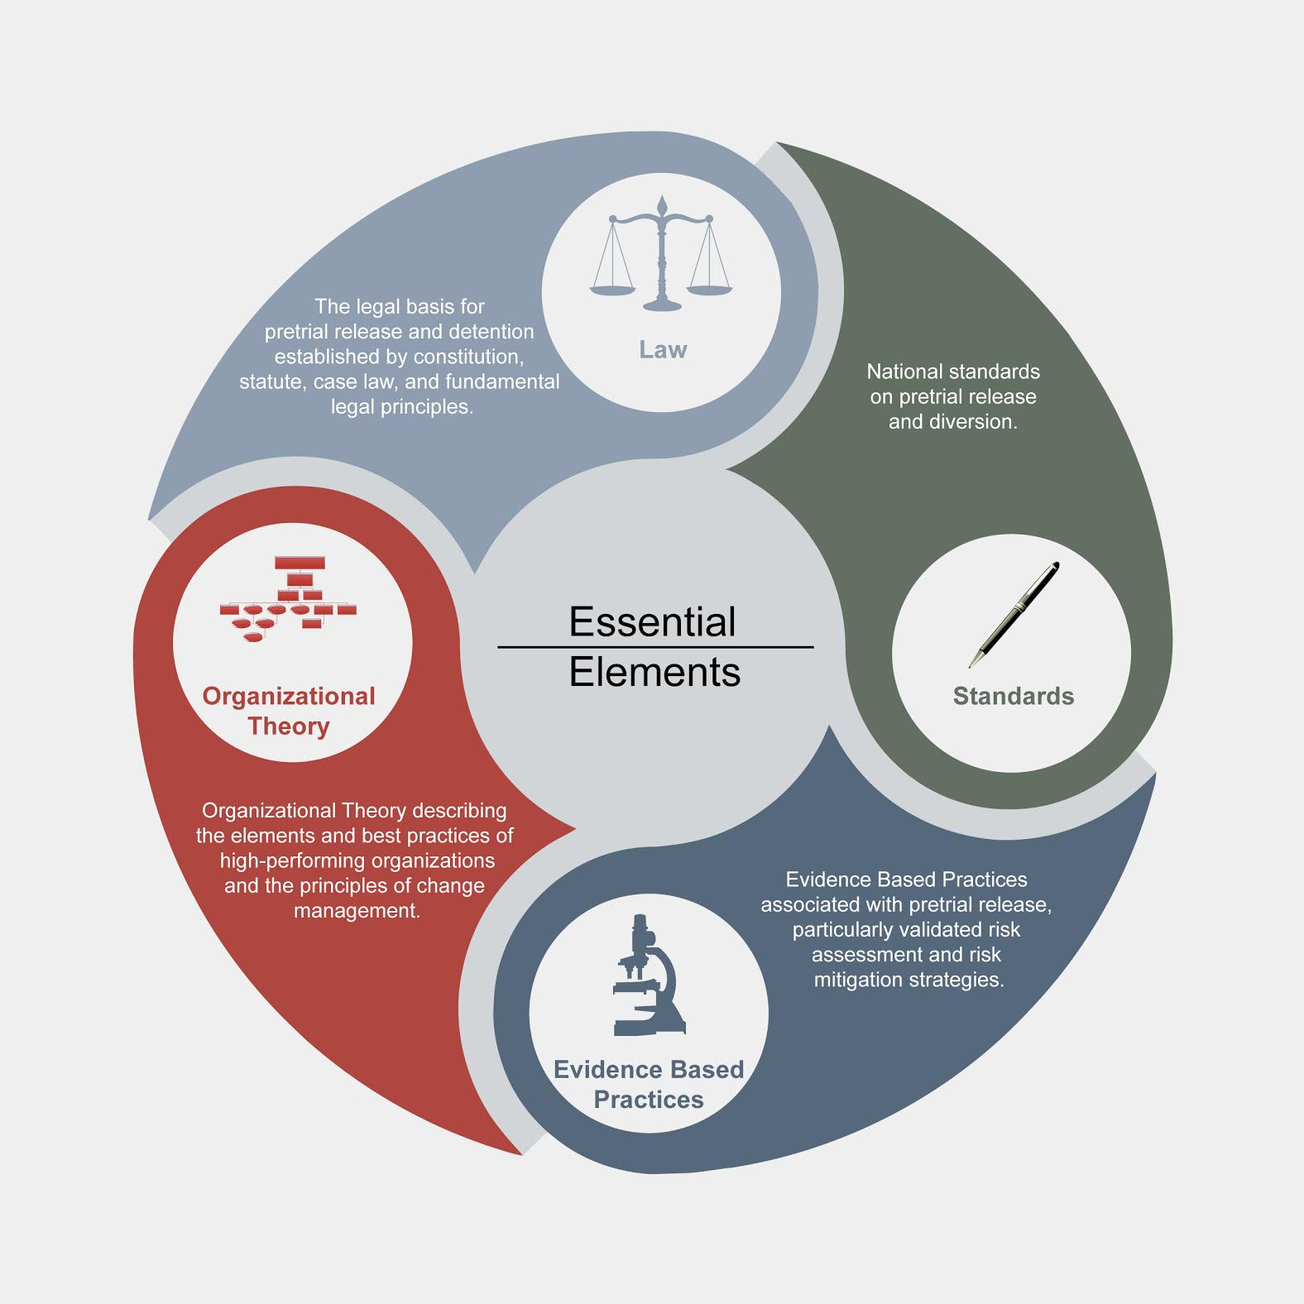
The Framework
Notes:
The Framework encompasses four dimensions:
--The legal basis for release and detention proscribed in state and Federal bail laws, case law and other legal opinion.
--Standards for pretrial release and diversion adopted by groups such as NAPSA, ABA and NDAA as well as state specific standards such as New York.
--Research and EBPs associated with pretrial release, particularly validated risk assessment and risk mitigation strategies.
--Organization Theory describing the elements and practices of high performing organizations, such as the emphasis on staff and customer satisfaction, work and functions associated with a clear mission, and use of outcome and performance measurement and feedback.
Explain that the Framework is evolving. Case law in New Mexico and elsewhere are reaffirming basic principles of bail. NAPSA Standards updated to reflect EBP. Research into supervision best practices.

Slide 5
 | Elements of a high functioning pretrial system Pretrial release and detention decisions based on risk and designed to maximize release, court appearance, and public safety Legal framework that includes presumption of least restrictive nonfinancial release; restrictions or prohibition against the use of secured financial conditions of release; and preventive detention for a limited and clearly defined type of defendant Release options following or in lieu of arrest Defendants eligible by statute for pretrial release are considered for release, with no locally-imposed exclusions not permitted by statute Experienced prosecutors screen criminal cases before first appearance Defense council active at first appearance Collaborative group of stakeholders that employs evidence-based decisionmaking to ensure a high functioning system Dedicated pretrial services agency

Slide 6
 | Elements of an effective pretrial agency Operationalized Mission Universal Screening Validated Pretrial Risk Assessment Sequential Bail Review Risk-based Supervision Performance Measurement and Feedback

Slide 7
Essential Elements of a Pretrial Justice System
A system-wide approach to real bail reform

Slide 8
“The 3 M’s” | Goal: To Maximize Court Appearance, Public Safety, and Release rates. All other essential elements flow from this defining principle. Appearance: “Bail set at a figure higher than an amount reasonably calculated to [ensure court appearance] is ‘excessive’ under the Eighth Amendment.” Stack v. Boyle 342 U.S. 1 (1951). Safety: Detention may be authorized when defendants are found “after an adversary hearing to pose a threat to the safety of individuals or to the community which no condition of release can dispel.” United States v. Salerno, 481 U.S. 739, 755 (1987). Release: “In our society, liberty is the norm, and detention prior to trial or without trial is the carefully limited exception.” Salerno.
Notes:
Bail decisions have appearance and public safety as their objectives. No other reasons are permissible in bail setting. The balance of least restrictive nonfinancial release for appropriate defendants is the adoption of legal, due process protected detention methods for truly risky defendants.

Slide 9
Legal Foundation | The proper legal framework greatly facilitates maximizing the 3M’s, and includes: A presumption of nonfinancial release on the least restrictive conditions necessary to ensure future court appearance and public safety. Prohibition or restrictions on the use of secured financial conditions. Provisions for detention without bail for a clearly defined and limited population of defendants who pose an unmanageable risk to public safety. Detention without bail must include robust due process protections for detention-eligible defendants and those detained. All three of these components are interrelated and must exist within a legal framework to achieve maximized rates of release, appearance, and public safety.
Notes:
For example, courts are far less likely to utilize formal preventive detention when secured financial conditions are allowed. Presumptive nonfinancial release—along with real and practical supervision options—keeps systems from applying preventive detention to an unnecessarily large defendant population or resorting to high bond amounts for higher-risk defendants.

Slide 10
Neither the Constitution nor our rules of criminal procedure permit a judge to base a pretrial release decision solely on the severity of the charged offense. Bail is not pretrial punishment and is not to be set solely on the basis of an accusation of a serious crime. As the United States Supreme Court has emphasized, “[t]o infer from the fact of indictment alone a need for bail in an unusually high amount is an arbitrary act.” Stack v. Boyle, 342 U.S. at 6. (Rule 5-401) requires the judge to make an informed, individualized decision about each defendant and does not permit the judge to put a price tag on a person’s pretrial liberty based solely on the charged offense.
State of New Mexico v. Brown No. 34,531.
Decided: November 6, 2014

Slide 11
Release on own recognizance. When from all the circumstances the court is of the opinion that the defendant will appear as required either before or after conviction and the defendant will not pose a danger to any person or the community and that the defendant will comply with all conditions of bond, the defendant shall be released on his or her own recognizance.
If the judicial officer determines that the release described in subsection(b) of this section will not reasonably assure the appearance of the person as required or will endanger the safety of any other person or the community, such judicial officer shall order the pretrial release of the person—
Detention. If, after a hearing pursuant to the provisions of subsection (e) of this section, the judicial officer finds that no condition or combination of conditions will reasonably assure the appearance of the person as required and the safety of any other person and the community, such judicial officer shall order the detention of the person before trial.
Notes:
New Jersey statute

Slide 12
(3) A judicial officer may not impose a financial condition under paragraph (1)(B)(xii) or (xiii) of this subsection to assure the safety of any other person or the community, but may impose such a financial condition to reasonably assure the defendant's presence at all court proceedings that does not result in the preventive detention of the person, except as provided in § 23-1322(b).
(4) A person for whom conditions of release are imposed and who, after 24 hours from the time of the release hearing, continues to be detained as a result of inability to meet the conditions of release, shall upon application be entitled to have the conditions reviewed by the judicial officer who imposed them. Unless the conditions of release are amended and the person is thereupon released, on another condition or conditions, the judicial officer shall set forth in writing the reasons for requiring the conditions imposed.
Notes:
DC Bail Law

Slide 13
Release Options Following or in lieu of Arrest | The legal principle of release on the least restrictive conditions starts with the initial contact with law enforcement. High functioning jurisdictions use citation releases or summonses by law enforcement in lieu of custodial arrests for non-violent offenses when the individual’s identity is confirmed and no reasonable cause exists to suggest the individual may be a risk to the community or miss the ensuing court date.
Notes:
LEAD, CIT, Summons as examples.

Slide 14
Multnomah County
Excluded:
Murder
Treason
Person crime w/ prior person crime
3rd DUI
Weapons
Burg I
Sex Offender Registry
Meth Man/Deal
(4,389/12%)
Arrest and Booking
(35,965)
Defendant scores 0-9 on Recognizance Risk Assessment
(4,935/14%)
Eligible Defendants Screened by Recognizance Unit
Traffic or Non-person Misdemeanor
(8,355/23%)
Pre Initial Appearance ROR or Referral to Pretrial Supervision
(13,289/37% of total)
Police and Recognizance Unit have override authority

Slide 15
No Locally-imposed Exclusions to Release | Pretrial systems screen all defendants eligible by statute for pretrial release consideration. Local justice systems do not impose limitations on pretrial screening and assessment eligibility beyond those established in the controlling bail law.

Slide 16
Criminal Case Screening | Trained and experienced prosecutors screen arrest filings before initial appearance to determine the most appropriate action. Early screening helps: reduce needless pretrial detention based on bail decisions made using arrest charges; aid prosecution in determining the most appropriate recommendations for pretrial release or detention; dispose of weaker cases sooner and target resources to higher level cases; and identify defendants eligible for diversion and other alternatives to adjudication. Screening outcomes range from dismissing or reducing charges, offering defendants referrals to diversion or problem-solving courts and preparing bail recommendations for initial court appearance.
Notes:
Cite the Baltimore example from the EEPSA.

Slide 17
Active Defense Counsel | Defense counsel engaged before initial appearance and prepared to represent the defendant regarding bail. The U.S. Supreme Court ruled in Rothgery v Gillespie County, 554 U.S. 191 (2008) that the initial bail hearing is a critical stage in the criminal case because liberty is at stake. Therefore, this decision point requires legal representation. The American Bar Association’s “Ten Principles of a Public Defense Delivery System” recommend that clients are screened for eligibility and defense counsel assigned as soon as feasible after clients’ arrest, detention, or request for counsel. Counsel should be furnished upon arrest, detention, or request, and usually within 24 hours thereafter.
Notes:
Bail is a “critical stage” in case processing given the liberty interest at stake. Most recently, the Supreme Court in Rothgery v. Gillespie County extended the right to counsel to apply at the initial appearance before a judge.
Currently, 42 states make legal counsel available at initial appearance.

Slide 18
We have, for purposes of the right to counsel, pegged commencement to “‘the initiation of adversary judicial criminal proceedings—whether by way of formal charge, preliminary hearing, indictment, information, or arraignment,’” (United States v. Gouveia, 467 U. S. 180, 188 (1984), quoting Kirby v. Illinois, 406 U. S. 682, 689 (1972)). The rule is not “mere formalism,” but a recognition of the point at which “the government has committed itself to prosecute,” “the adverse positions of government and defendant have solidified,” and the accused “finds himself faced with the prosecutorial forces of organized society, and immersed in the intricacies of substantive and procedural criminal law.” (Kirby at 689).
We merely reaffirm what we have held before and what an overwhelming majority of American jurisdictions understand in practice: a criminal defendant’s initial appearance before a judicial officer, where he learns the charge against him and his liberty is subject to restriction, marks the start of adversary judicial proceedings that trigger attachment of the Sixth Amendment right to counsel.
Rothgery v Gillespie County, 554 U.S. 191 (2008)

Slide 19
Collaborative Stakeholders | Inter-agency coordination that help allocate scarce resources efficiently, reduce jail overcrowding, and increase public confidence in and support for criminal justice processes, enhancing system performance and, ultimately, the integrity of the law. Coordinating bodies include all three branches of government and other relevant stakeholders and address specific and systemic issues. Within the pretrial context, coordinating bodies analyze current performance (e.g., of detain/release decisions), and suggest opportunities for improvement. NACo, JMI and BJA (2014). "From Silo to System: The Importance of Criminal Justice Coordinating Councils (CJCCs)" (Webinar). http://www.naco.org/sites/default/files/event_attachments/NACo%20From%20Silo%20to%20System%20-%20Sept%2024.pdf.

Slide 20
8 Characteristics of Highly Effective Teams | A Clear and Elevating Goal Results-Driven Structure Competent Team Members Unified Commitment Collaborative Climate Standards of Excellence External Support and Recognition Principled Leadership TeamWork: What Must Go Right/What Can Go Wrong, Carl E. Larson and Frank M. LaFasto. 1989. Sage Publications.
Notes:
The Eight Characteristics of Highly Effective Teams
Adapted from concepts in TeamWork: What Must Go Right/What Can Go Wrong, by Carl E. Larson and Frank M. LaFasto. 1989. Sage Publications.
A Clear and Elevating Goal
High performance teams have both a clear understanding of the goal to be achieved and a belief that the goal embodies a worthwhile or important result; teams with a “clear and elevating goal” understand that whether the team succeeds clearly makes a difference.
Has your team defined a clear and elevating goal for an evidence-based pretrial justice system? Is such a goal already emerging? If not, what should be done?
Results-Driven Structure
The importance of structure is not in its presence or absence. More important is whether a structure is in place that is appropriate for the achievement of the performance objectives. To be successful, a team’s structure should be designed around the results to be achieved.
Policy teams are established to lead, guide, direct, and manage. Their sphere of influence is far-reaching and the nature of the problems they are established to address are typically intricate and complex. Their membership is composed of officials who have the authority and responsibility to assure the achievement of the “clear and elevating goal.”
There are three kinds of teams:
Problem resolution teams – are established to resolve problems on an ongoing basis. Their most necessary feature is trust; members must believe in the integrity of their colleagues and feel secure in an atmosphere of collegiality and respect.
Creative teams – are established to innovate. Their necessary feature is autonomy from systems and procedures. In other words, they must have the latitude to explore new possibilities and alternatives, be willing and able to abandon normative thinking, and serve as the incubator for new ideas.
Tactical teams – are established to execute a well defined plan. Their most essential feature is clarity in task and an unambiguous role in the carrying out of the plan.
There are four necessary features to team structure:
Clear roles and accountabilities – each member’s relationship to the team is defined in terms of the role to be assumed and the results the role is to produce;
An effective communication system – opportunities for team members to discuss team issues in a relaxed environment (social and informal interaction opportunities) are essential; methods for documenting issues raised and decisions made are important as well;
Monitoring performance and providing feedback – establishing systems of checks and balances to assure performance meets expectations is a must; and
Fact-based judgments – objective and factual data should be the basis of the team’s sound decision-making.
Does your team have a results-driven structure? If not, what should happen to create one?
Competent Team Members
Competency is defined as the necessary skills and abilities to achieve the desired objective (technical competencies) and the personal characteristics required to achieve excellence while working well with others (personal competencies).
Technical competencies are minimal requirements of any team. They include substantive knowledge, skills, and abilities related to the specific tasks to be accomplished.
Personal competencies refer to the qualities, skills, and abilities necessary for individual team members to identify, address, and resolve issues.
There are three common features of competent team members:
The essential skills and abilities to conduct the work;
A strong desire to contribute; and
The capacity to collaborate effectively.
Do you have all of the key stakeholder groups represented on your team? If not, who is missing? Are there specific talents or skills that specific individuals possess that will help the team move forward? How can these be tapped?
Unified Commitment
A unified commitment is best characterized by “team spirit,” or a sense of loyalty and dedication to the team. It may be exhibited by an unrestrained sense of excitement and enthusiasm for the team and its work; a willingness to do anything that has to be done to help the team succeed; and an intense identification with the people who are the team.
There are two significant features of this characteristic:
Commitment to the effort – teams do not excel without significant investment of individual time and energy; and
Unity – group spirit and teamwork are indispensable to superior performance.
What is being done/can be done to nurture “team spirit” and commitment?
Collaborative Climate
A collaborative climate is most commonly described in the adage, “The whole is greater than the sum of its parts.” Teams operating in a truly collaborative climate work well together and trust is a mainstay virtue.
Trust is produced in a climate that includes three elements:
Honesty (i.e., integrity and truthfulness, absent exaggeration);
Consistency (i.e., predictable behavior and responses); and
Respect (i.e., treating people with dignity and fairness).
To what degree is there a collaborative climate within the team? What can be done to enhance it?
Standards of Excellence
Standards define those relevant and very intricate expectations that eventually determine the level of performance a team deems acceptable. Standards determine the type of technical competency required, the amount of initiative and effort required, how people are expected to behave with one another, how firm the deadlines are, and how the results will be achieved. Ultimately standards dictate the rewards for success and the consequences for failure.
Pressure to perform can come from a variety of sources:
Individual standards;
Team pressure;
The consequences of success or failure (reaching the clear and elevated goal);
External pressure; and
The team leader.
Three variables are integral to establishing and sustaining standards of excellence. The extent to which:
Standards are clearly and concretely articulated;
Team members require one another to perform according to the established standards of excellence; and
A team exerts pressure on itself to improve.
Does your team have clear standards of excellence? If not, how can they be established?
External Support and Recognition
External support and recognition is measured by the extent to which those individuals and agencies outside the team, who are capable of contributing to the team’s success, acknowledge and support the work of the team. (Interestingly, the external support and recognition factor seems to be more an effect of team success than a cause of it. It is noted more for its absence in poorly functioning teams than its presence in highly effective teams.)
Does your team/do the pretrial pilot teams have (or need) external support and recognition?
Principled Leadership
Leadership can add tremendous value to any collaborative endeavor, even to the point of sparking the outcome with an intangible kind of magic. Effective leaders draw together – often in a seemingly effortless yet inspiring way – vision, a belief in the opportunity for change, and the ability to meaningfully involve others.
Effective leaders:
Establish a vision of the future;
Enlist others to embrace the vision;
Create change; and
Unleash the energy and talent of contributing members.
Does your team have principled leadership? If so, is it being fully utilized? If not, how can it be engendered?
Adapted from concepts in TeamWork: What Must Go Right/What Can Go Wrong, by Carl E. Larson and Frank M. LaFasto. 1989. Sage Publications.

Slide 21
Essential Elements of an Effective Pretrial Services Agency
The basic for high functioning pretrial agencies

Slide 22
Pretrial Services Agencies | A dedicated pretrial services agency ensures that management of essential functions occurs under a single organization goal and better coordination among elements—for example, ensuring that release recommendations match supervision resources and capacity. A single management structure also provides better staff direction and motivation to critical work priorities and clearer lines of communication. The justice system has also has a single actor responsible for pretrial functions. Preferably, the pretrial services agency should be a separate, independent entity. Jurisdictions may incorporate pretrial services agencies within a larger “parent” organization, if that component has: a clearly-defined, pretrial service related function as its purpose; staff assigned only to pretrial-related work with pretrial defendants; and management that can make independent decisions on budget, staffing, and policy.

Slide 23
Pretrial Services Agencies | Help courts make informed bail decisions. Promote maximized pretrial release, appearance, public safety, and compliance outcomes. Ensure that release options are realistic, enforceable, and measurable.

Slide 24
Several jurisdictions have legislation authorizing or encouraging pretrial services agencies:
Kentucky
Federal courts
Washington, D.C.
Virginia
Illinois
Colorado
Hawaii
Nevada
New Jersey
Vermont
West Virginia
Alaska

Slide 25
Assess
Background investigation
Promote
Supervision
Support
Measure
Metrics
Satisfaction
Validated Risk Assessment
Recommendations
Monitoring
Feedback
Integrate
Needs Assessment
Mental Health
Substance Abuse
Defendant interview
Criminal history check

Slide 26
Operationalized Mission Statement | A mission statement identifies a program’s focus and desired outcomes. Tells the world who you are and why you’re important. Guides agency structure and day-to-day operational decisions. Focuses Leadership, Staff and Customers on goals and principles. Gives Management a clear leading message and set of principles. Helps define agencies within a larger organization.

Slide 27
PSA’s mission is to assess, supervise, and provide services for defendants, and collaborate with the justice community, to assist the courts in making pretrial release decisions. We promote community safety and return to court while honoring the constitutional presumption of innocence.
Pretrial Services Agency for the District of Columbia
(2008)
Promote pretrial justice and enhance community safety
(current)

Slide 28
Outcomes
Strategic Goals
Strategic Objectives
Appearance
To promote pretrial justice and enhance community safety
Safety
Continued Release
Judicial Concurrence with PSA recommendations
Continued compliant pretrial release
Minimize rearrests
Maximize court appearance
Risk assessment
Risk-based supervision
Behavioral Health integration
Effective agency administration
Measurement

Slide 30
screening
[ˈskrēniNG]
NOUN
screenings (plural noun)
the evaluation or investigation of something as part of a methodical survey, to assess suitability for a particular role or purpose.
Universal Screening
Ensuring Bail Eligibility

Slide 31
Pretrial services agencies should screen all defendants eligible by statute for bail to make informed, individualized recommendations to the court.
The Rule:

Slide 32
Defendant Interview
Criminal History Check
Verification
Risk Assessment

Slide 33
Screening should occur before the defendant’s initial court appearance so that the judicial officer can factor screening results into his or her release decision.
Screening results also can help determine the defendant’s eligibility for pretrial diversion options or the need for referrals to behavioral health or social services programming to augment pretrial supervision.
Recommendations should not depend on a defendant’s participation in a screen

Slide 34
Re-Thinking Risk
as·sess
[əˈses]
VERB
evaluate or estimate the nature, ability, or quality of.
evaluate · judge · gauge · rate · estimate · appraise ·
form an opinion of · check out · form an impression of · make up one's mind about · get the measure of · determine · [more]
Lessons from Risk Assessment science

Slide 35
Session Goals
Define Pretrial Risk Assessment
Definition
Goals
Best Practices
Discuss the Nature of Pretrial Risk
Analyze Real-world RAI Outcomes

Slide 36
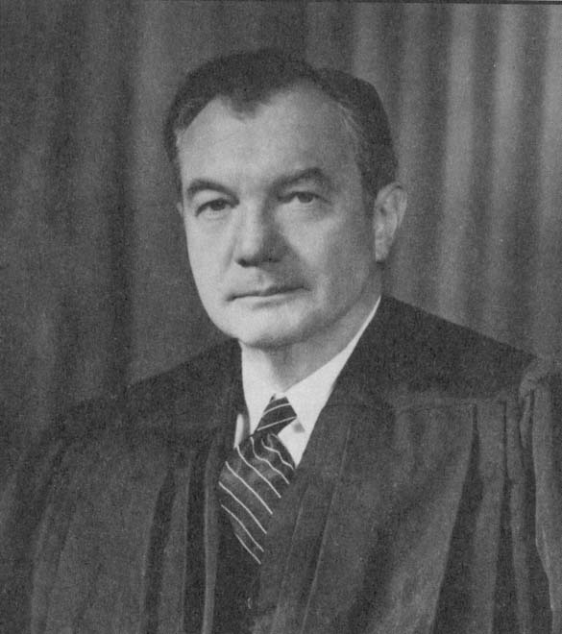
Admission to bail always involves a risk that the accused will take flight. That is a calculated risk which the law takes as the price of our system of justice.
Stack v. Boyle 342 U.S. 1 (1951) at p. 8.
Notes:
Risk is inherent in bail decision-making. As defined by law, “bail” grants a reasonable assurance of an individual’s return to court and public safety. The goal is not to eliminate any chance of failure, but to recognize it as “the price for our system of justice” and to manage it in a way that promotes pretrial release and successful outcomes. But the presence of risk needn’t make bail decision-making a gamble. We can study risk, define it more accurately, gauge how likely it is to occur in our defendant populations, and, ultimately, learn how best to manage it.
The need to understand pretrial risk helped spur one of the past decade’s most important areas of criminal justice research. This work sought to identify the factors that predict the likelihood of a missed court date and new criminal activity pretrial. This new body of knowledge led to an array of pretrial risk assessment instruments validated by research on local or multi-jurisdictional defendant populations. Today, over a dozen validated PRAIs exist, some available in the public domain to interested practitioners, and others proprietary to a particular jurisdiction. Many of these instruments are “fourth generation” assessments that predict the likelihood of risk and integrate case planning and risk management into the assessment.
Based on this body of knowledge, practitioners know more about risk at the pretrial stage now than at any point during the bail reform era that began in the 1960s. However, this new knowledge has not been applied to the most basic questions about pretrial risk and therefore, not been an effective tool in policy and legal discussions regarding bail. This publication looks at RAI research and the data from jurisdictions implementing validated risk instruments to answer the following questions:
Ultimately, how we understand and address risk determines our commitment to the principle of bail as a means to maximize release while promoting appearance and safety. An understanding of risk borne out by research and outcome data from courts nationwide can greatly inform and improve a court’s bail decision-making. We hope this paper helps to inform the discussion and to show the true nature or risk in defendant populations.

Slide 37
What is “pretrial risk”?
How likely are defendants to fail?
How good are we at assessing risk?
What factors are most predictive of pretrial risk?
What’s the best method to assess pretrial risk?
Quiz:

Slide 38
Defining Risk
A defendant’s likelihood of:
Missing a scheduled court date
Arrest on a separate criminal offense
“global” rearrests
rearrests on specific charge types

Slide 39
Notes:
Data show that pretrial misconduct isn’t as common as most believe.

Slide 40
Assessing Risk
Fourth Generation: Explicit integration of risk/needs management into assessment. The goal extends beyond risk assessment to enhancing supervision and treatment. (Examples: Ohio Risk Assessment System (ORAS), Wisconsin Risk and Needs Tool (WRN), Public Safety Assessment (PSA)).

Slide 41
Assessing Risk
The consensus from the behavioral science, economic, and criminal justice fields is that actuarial risk assessment is the superior method.
Adjusted actuarial assessments—where practitioners have limited and well defined rules to override RAI results—is the preferred actuarial risk assessment technique.

Slide 42
ASSESS
Gather data
ADJUST
Consider mitigating and aggravating circumstances
RECOMMEND
Recommend supervision level and conditions consistent to risk level and other factors
Apply the tool
Calculate result
Adjust supervision response as needed

Slide 43
What’s Out There?
Court PSA
Virginia (VPRAI Revised)
Federal Court (FRAI)
Ohio (ORAS/PAT)
Colorado (CPAT)
Florida RAI
Alaska
Nevada (NPR)
Locally-validated assessments
Washington, DC
Allegheny County, PA
El Paso, TX

Slide 44
Where do PRAIs Come From?
Bivariate analyses: Identify relationship of independent variables to the dependent variables.
Logistic regression: Measure the strength of relationship between independent and dependent variables. Weighting of variables on a risk scale.
ROC AUC (Receiver Operating Characteristic/Area under the Curve): Determination of the improvement of risk prediction over chance.
Test on validation set.

Slide 45
Static
Dynamic
History of FTA
Previous Felonies
Previous Incarcerations
Pending Charges
Previous Misdemeanors
Substance Abuse
Residence
Employment
Age

Slide 46
Notes:
Criminal History factors tend to predict outcomes better than other factors

Slide 47
Notes:
SCPS data 2002. Also cite University of Utah validation study of Salt Lake showing 85% of rearrests were drug and property charges and only 25% were violent.

Slide 48
RAIs: The Results

Slide 49
RAIs: The Results

Slide 50
RAIs: The Results

Slide 51
RAIs: The Results

Slide 52
Notes:
Kentucky 2016

Slide 53
Notes:
Allegheny County

Slide 54
54
The Violence Flag

Slide 55
Cautions
RAIs show the “group” to which you belong, not your individual risk level
The definition of “risk” is relative and not consistent in the research
Separate assessments are the better practice, although some risk factors are predictive of both court appearance and arrest-free behavior
RAIs should not be the final say on release/detention

Slide 56
Issues
RAIs and Pretrial Interviews
Locally validated vs. publicly available RAIs
Supervision to match risk factors and levels
When needs play a role
Inter-rater Reliability and Quality Assurance
Staff Overrides

Slide 57
Questions?

Slide 58
DMF Matrix and “Risk Tolerance”
 | NCA 1 | NCA 2 | NCA 3 | NCA 4 | NCA 5 | NCA 6
FTA 1 | Level 1 (15.4%) | Level 1 (10.6%)
FTA 2 | Level 1 (1.3%) | Level 1 (7.5%) | Level 2 (8.5%) | Level 2 (11.3%) | Level 3 0
FTA 3 |  | Level 2 (5.1%) | Level 2 (9.5%) | Level 3 (4.4%) | Level 4 (3.0%) | Level 5 (0.03%)
FTA 4 |  | Level 3 (2.0%) | Level 3 (3.7%) | Level 3 (3.7%) | Level 4 (4.1%) | Level 5 (0.03%)
FTA 5 |  | Level 4 0 | Level 4 (0.03%) | Level 4 (1.7%) | Level 4 (2.7%) | Level 5 (1.0%)
FTA 6 |  |  |  | Level 5 (0.03%) | Level 5 (0.06%) | Level 5 (1.7%)
Notes:
Risk Tolerance: Amount of risk that communities are willing to take when considering the current offense • Nature and circumstances of the offense is a legitimate consideration • Expectation that the release and detention decision would be more restrictive for certain types of offenses even when the risk level is the same
Risk Tolerance: Seriousness of the current offense is a legitimate factor to consider, and risk tolerance would dictate more restrictive recommendations for certain types of charges
Differential Supervision: Defendants supervised under a differential supervision strategy based on risk as identified by the VPRAI are less likely to fail to appear and experience a new arrest
Praxis Foundation : No Financial Bonds ▪ Pretrial Services agencies policy decision that bail status recommendation will be either release or detain

Slide 59
sequential
[səˈkwen(t)SHəl]
ADJECTIVE
screenings (plural noun)
forming or following in a logical order or sequence.
Sequential Bail Review
Continuing the Risk Principle

Slide 60
Judicial officers have authority to make determinations regarding bail in all stages of a criminal case, up to and including the trial stage
Federal Bail Reform Act
18 USC § 3141 (a)

Slide 61
Notify the Court of continued after the initial pretrial court appearance and offer the Court judicial officer reviewing the bail non-financial options appropriate to the defendant’s assessed risk level.
For detained defendants, notify the court of any new favorable information that would aid in facilitating a defendant's release or information that would affect the defendant's status while on release.
Encourage defense counsel and prosecutors to notify the agency of changes in circumstances that would affect the defendant's bail status.
Review the status of released defendants, including a check for new criminal arrests and compliance with conditions of release.

Slide 62
Session Goals
Describe Pretrial Supervision
Purpose
Risk Based
Conditions
Discuss how risk assessment should inform Supervision strategies
Compliance
Discuss what we know about best and promising practices

Slide 63
Most defendants will make scheduled court dates and remain arrest-free pending adjudication. The goal of supervision, mitigation, and support strategies is to promote that success among the greatest number of defendants.
Promote Success rather than Manage Risk

Slide 64
Risk-based Interventions | Using the least restrictive interventions needed to promote court appearance and community safety

Slide 65
Goal: promote court appearance and public safety. (Excludes rehabilitation, punishment, restitution)
Conforms to the Risk Principle and the idea of least restrictive conditioning. No “blanket” conditioning.
Interventions start with OR and progress as risk levels and behaviors warrant.
Incorporates treatment when needs become risk factors

Slide 66
Supervision Supports | Effective pretrial supervision includes: Notification to defendants of upcoming court dates Early and meaningful responses to defendant conduct Notification to the Court of defendant conduct and the possible need for supervision adjustment
Notes:
Research show that effective pretrial supervision includes the last three: Notification to defendants of upcoming court dates
Early and meaningful responses to defendant conduct and Notification to the Court of defendant conduct and the possible need for supervision adjustment

Slide 69
In Kentucky, we are striving to limit costly and unproven options for release. We provide court date notifications and monitor for new criminal activity and court appearance for every defendant released. In the past 12 months, only 3% of the 135,324 people released before trial were placed on supervision. We choose to recommend release with minimal supervision for a lot of people and we get good results.
For high-risk defendants—only about 12% of all arrested people—standard supervision in Kentucky entails one contact (either by phone or in person) with the defendant per month, court notification and compliance verification. Even with supervision this minimal, high-risk defendants only get arrested 14% of the time while on pretrial release and 79% show up for court when scheduled.

Slide 71
What We Know
The body of knowledge about evidence-based and best Pretrial Supervision practices is still developing.
Levels of supervision appear to influence outcomes, but the effect of individual conditions is an open question.
Risk assessment and outcome and performance measurement data suggest that low to moderate supervision levels are appropriate for most defendants.

Slide 72
Supervision levels tied to assessed risk levels greatly improve pretrial outcomes. Conversely, improper supervision produces poor outcomes and wastes resources. (The “risk principle”).
Drawing on data from two states, the Laura and John Arnold Foundation examined the likelihood of new criminal arrest and failure to appear for defendants released pretrial with supervision and those released without supervision. The study found that moderate- and high-risk defendants who received pretrial supervision were more likely to appear in court, and all defendants who were supervised pretrial for 180 days or more were less likely to be arrested for new criminal activity.
Van Nostrand, M. and Lowencamp, C. 2013. Exploring the Impact of Supervision and Pretrial Outcomes. New York: LJAF

Slide 73
73
Supervision levels tied to assessed risk levels greatly improve pretrial outcomes. Conversely, improper supervision produces poor outcomes and wastes resources. (The “risk principle”).
Moderate and higher risk defendants who were required to participate in ATD (e.g., drug testing, treatment, electronic monitoring) were more likely to succeed pending trial.
Lower risk defendants who were required to participate in ATD pending trial were more likely to fail pending trial
VanNostrand, M., & Keebler, G. (2009). Pretrial Risk Assessment in the Federal Court. Federal Probation, 72 (2)

Slide 74
Conditions | Tied to mitigating risk of nonappearance or public safety Least restrictive Individualized (NO blanket conditions) Research about what specific conditions best mitigate which risk is lacking

Slide 75
Conditions- The research
Court Notification (Appearance):
✓Solid evidence-based practice. Should be used as a uniform intervention. Could be the baseline for low/moderate level supervision.
Notes:
Mention that agencies usually don’t have enough information at initial appearance to recommend substance abuse or mental health treatment.

Slide 76
Conditions- The research
Drug testing (Appearance, Public Safety):
Results are mixed and dated. Drug use often is a behavior, not a risk factor. Used when specific drug has a link to pretrial failure. Should not be a blanket condition. Don’t drug test alone if there is an IOP or greater treatment need. Keeping up with drug use trends is a must.
Electronic Surveillance (Safety):
No evidence of safety benefit, though limited study suggests an appearance outcome benefit. Best used to monitor stay away and curfew conditions. Can encourage nonfinancial release but also increased technical violations. Possible legal issues with targeted populations and costs imposed on defendants.
Notes:
Does GPS Supervision of Intimate Partner Violence Defendants Reduce Pretrial Misconduct? Evidence from a Quasi-Experimental Study. Eric Grommon Jason Rydberg, Jeremy G. Carter,: Pretrial GPS supervision is no more or less effective than traditional, non-technology based pretrial supervision in reducing the risk of failure to appear to court or the risk of rearrest. GPS supervision does reduce the risk of failing to appear to meetings with pretrial services staff. (2017)

Slide 77
Conditions- The research
Regular Reporting (Appearance):
No significant research to date. Best used to verify court dates and as a complement to other conditions.
Treatment (Appearance and Safety):
Let’s Talk.

Slide 78
Issues
Infractions versus Violations
Addressing failures to appear and arrests
Reporting compliance to Court
Sequential bail review
Need versus Risk

Slide 79
Questions?

Slide 80
Measuring for Results
meas·ure
[ˈmeZHər]
VERB
ascertain the size, amount, or degree of (something) by using an instrument or device marked in standard units or by comparing it with an object of known size.
calculate · compute · estimate · count · meter
Using Outcome and Performance Measures to Achieve Mission and Goals

Slide 81
Session Goals
Improve rates and results of pretrial release, public safety, and court appearance
Create a results-oriented culture that values mission-related strategic functions
Promote smarter decisions about agency resources, quality and effectiveness
Define pretrial agencies’ value in a high-functioning justice system

Slide 82
Data are good…
…Results are better

Slide 83
“When you have mastered numbers, you will in fact no longer be reading numbers, any more than you read words when reading books. You will be reading meanings.”
“Statistics are used like a drunk uses a lamp post: for support, not illumination”
Harold S. Geneen
Vince Scully

Slide 84
The Issue
Many pretrial agencies don’t know how to define “success” or measure progress towards strategic outcomes. A focus on “busy data” prevents leaders from measuring what really matters to their programs, systems, defendants and communities.
BOTTOM LINE: Pretrial Leaders must move from “data driven” to “results oriented.”

Slide 85
Goals
Achieve better results in public safety, court appearance and defendant accountability
Create a results-oriented culture that values mission-related strategic functions
Allow pretrial agencies to show through solid performance oriented information their value in a high-functioning criminal justice system
Allow better decisions on agency resources, quality and effectiveness

Slide 86
Measurement Promotes Results
Shifts the organization’s focus from activities to results, from how a program operates to the good it accomplishes
Frees leaders to lead
Focuses and motivates management and staff on common goals and purposes
Identifies what works and what’s promising
Positions organization within the system and community as successful, increasing support and resources

Slide 87
Measures are numeric (rates, totals) or qualitative (perception, feedback) indicators of how well an organization performs its mission-related and strategic functions.
Outcome measures focus on mission
Performance measures gauge operational goals that support the mission.

Slide 88
Inputs: Resources used to produce goods or services, including human, financial, facility, or material resources. Example: number of defendants supervised, number of defendants needing treatment or community service placements.
Outputs: Indicators that count an organization’s services and goods. Example: the number of assessments, program placements, sanctions imposed.

Slide 89
Efficiencies: Indicators of an organization’s achieving a stated target. Example: percent of defendants sanctioned for noncompliance.
Outcomes: Indicators of the actual impact of an organization's actions. An outcome measure is a means for quantified comparison between the actual result and the intended result. Example: Appearance, safety, success and recidivism.

Slide 90
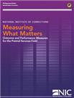
www.nicic.gov/library/025172

Slide 91
Appearance rate: the percentage of supervised defendants who make all scheduled court appearances.
Recommended Data: Cases with a verified pretrial release and/or placement to the pretrial program and the subset of this population that have no bench warrants/capiases issued for missed scheduled court appearances.
The appearance rate also may be tracked by various defendant populations, although the primary group targeted should be defendants released to the agency’s supervision.
Notes:
This is the central outcome measure for pretrial services programs. Nearly all programs have maximizing appearance rates as part of their mission. Enabling legislation or local rules for pretrial programs usually cite court appearance as a chief objective. National pretrial release standards identify minimizing failures to appear as a central function for pretrial programs.

Slide 92
Safety rate: the percentage of supervised defendants who are not charged with a new offense during case adjudication. A new offense is one:
whose offense date occurs during the defendant’s period of pretrial release;
that includes a prosecutorial decision to charge; and
that carries the potential of incarceration or community supervision upon conviction.
This excludes arrest warrants executed during the pretrial period for offenses committed before the defendant’s case filing.
Recommended Data: the number of defendants with a verified pretrial release or placement to the pretrial program and the subset of this population with no rearrests on a new offense. Programs also may track separate safety rates by charges type (for example, misdemeanors, felonies or local ordinance offenses) or severity (violent crimes, domestic violence offenses or property crimes) or by defendant populations.

Slide 93
Concurrence rate: the ratio of defendants whose supervision level or detention status corresponds to their assessed risk of pretrial misconduct. This measure excludes defendants detained on statutory holds, probation or parole warrants or holds and detainers from other jurisdictions.
Recommended Data: the number of release and detention recommendations and subsequent release and detention outcomes.
Notes:
Conditions of supervision recommended and imposed do not have to match exactly; however, the overall supervision level should be comparable. For example, a recommendation for release on personal recognizance with no conditions would not match a release with a weekly reporting requirement.

Slide 94
Success rate: the percentage of released defendants who are 1) not revoked for technical violations, 2) appear for all scheduled court appearances, and 3) remain arrest-free. The measure excludes defendants that are detained following a guilty verdict and those revoked due to non pretrial related holds.
Recommended Data: the total number of defendants released to the program and the subset of this population that experience no condition violations, failures to appear or rearrests.

Slide 95
Creating Measures
Mission
Outcome I
Goals
Strategic Area 1
Objectives
Performance Measure 1
Performance Measure 2
Outcome II
Outcome III
Performance Measure 3
Strategic Area 2
Strategic Area 3

Slide 96
Lessons on Implementation
Tie measures to mission, goals and objectives. Use performance measurement to track progress and direction toward strategic objectives.
Use results for mission-driven items. Performance data should be the foundation for new initiatives, budgets, strategic planning, and priorities.
Create a measurement framework and advertise it at all levels. Everyone must know how measures relate to their work. Accountability is key as is knowing that what you do is worthwhile.
Create positive measurement systems. Successful performance frameworks are not "gotcha" systems, but learning environments that help the organization identify what works/what doesn’t and continue with/improve on what works and fix/replace what doesn’t.
Notes:
In February 1997, NPR published the Benchmarking Study Report Best Practices in Customer-Driven Strategic Planning, which documents and details the in-depth processes and approaches of those best-in-class organizations that excel at incorporating their customers' needs and expectations into their strategic planning processes. This study provided public and private leaders and managers with world-class practices and formulas for success in developing and deploying agency strategic plans and goals. To complement this strategic planning study, NPR commissioned the first-ever intergovernmental benchmarking consortium involving not only U.S. federal agencies, but also local governments and the government of Canada in a collaborative study of performance measurement.
This report documents the Performance Measurement Study Team's findings, and will be a useful tool for public and private leaders and managers in identifying and applying best-in-class performance measurement and performance management practices. When used in conjunction with the Customer-Dri

Slide 97
Questions?

