Slide 1
Emergent and Community-Based Health Care Utilization by Previously Incarcerated Individuals
Eugenie Hughes, MD
June 2022

Slide 2
Disclaimer
Opinions contained within the presentation are those of the author and not statements of the ACRJ, R10, or the UVA Emergency Department. The information provided therein is as of June 2022. It may be shared with interested parties for informative purposes but may not be extrapolated or published without written permission of the author.

Slide 3
Study Design: From Winter 2019 to Now
Notes:
This project was possible through partnership with a number of entities, which I highlight here. It started back in February of 2019 with a stakeholders interest meeting, from which the beginnings of a data sharing agreement between myself, the ACRJ, R10 and the UVA Systems Engineers was created. Some of you on this meeting today may remember being present at that initial meeting.

Slide 4
Study Design: From Winter 2019 to Now
Knowing the Issue
Albemarle/ Charlottesville may better understand the scope of the mental health and substance abuse burden on previously incarcerated individuals.
Preventative Health Care The results of this study may enable Region 10 to better understand the impact of their services on ED visits.
Inmate Programming
This study may provide the ACRJ with information on the health needs of its inmates, setting up potential for addressing recidivism.
Going Forward
Maintain community of trust between OAR, ACRJ, R10, and UVASOM.
Notes:
This project faced bureaucratic hurdles but was possible though the patience and trust of the previously mentioned data partners. My research aims to help fill the knowledge gap on the health needs of the jail population by focusing on the relationship between emergency department utilization and the utilization of Region 10 for substance use and mental health care.

Slide 5
Emergency Department Utilization of Previously Incarcerated Individuals
35% of individuals had 3 or more ED visits within 1 year of release from prison
Nearly 25% had an ED visit within 1 month of release
43% more likely to be to be presenting with a mental health disorder than the general public
Nearly 2x as likely to be presenting with substance use disorder
Notes:
This was a topic I was interested in because we know that previously incarcerated individuals have a higher health burden than the general public, with a particularly high burden of mental health.
We know that mental health and substance use disorders are dramatically over-represented in prison populations, and the data on this slide is a brief summary of prior research showing the related demand for these services.
However, there is a lack of research on the emergency department utilization of with those recently released from jail. We know that the jail population is a much more transient one, with different characteristics, potentially representing unique health needs. By further understanding the ED utilization of these previously incarcerated individuals, we may be able to better inform interventions aimed at reducing mortality, morbidity, and recidivism, especially as it relates to mental health and substance use.

Slide 6
Hypothesis: Receiving outpatient services for mental health and substance use would decrease the rate at which individuals utilize the ED within a year of release from jail
Notes:
I hypothesized that receiving outpatient services for mental health and substance use at Region 10 would decrease the rate at which individuals utilize the ED within a year of release from jail.

Slide 7
Study Focus
1. Emergency department utilization of individuals within 12 months of release from the ACRJ
2. Utilization of Region 10 services for mental health and substance use for this same population.
3. Examining if there is any effect or relationship between receiving R10 services and utilization of the emergency department.
Notes:
I explored this hypothesis by looking at:
1. Emergency department utilization of individuals within 12 months of release from the ACRJ
2. Utilization of Region 10 services for mental health and substance use for this same population.
3. Examining if there is any effect or relationship between receiving R10 services and utilization of the emergency department.

Slide 8
ACRJ Dataset Jan 2009-Dec 2021 n=21339
Limit to 2019
2019 ACRJ Dataset n=2702
Limit to Eligible Release Types
ACRJ Sample n=2266
10 % Random Sample
Study Sample n=216
Every booking event for each subject
Record Variables of Interest; Classify Arrests as Substance Related
Search EMR for Subjects
Exclude Subjects without MRN
Record ED Visits within 12mo Release n=180
Include OSH data if available in EHR
METHODS—Database Arm 1: Jail and Emergency Department Data
Notes:
Through the executed data sharing agreements, I had access to every booking event at the ACRJ from 2009-2021, representing over 21,000 unique individuals.

Slide 9
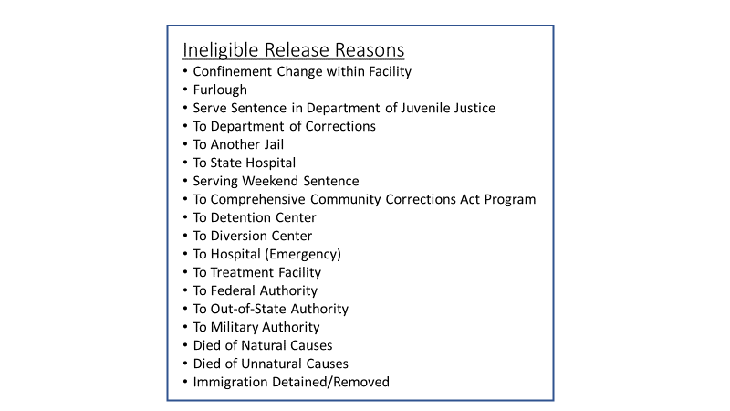
ACRJ Dataset Jan 2009-Dec 2021 n=21339
Limit to 2019
2019 ACRJ Dataset n=2702
Limit to Eligible Release Types
ACRJ Sample n=2266
10 % Random Sample
Study Sample n=216
Every booking event for each subject
Record Variables of Interest; Classify Arrests as Substance Related
Search EMR for Subjects
Exclude Subjects without MRN
Record ED Visits within 12mo Release n=180
Include OSH data if available in EHR
METHODS—Database Arm 1: Jail and Emergency Department Data
Notes:
I decided to first limit my sample to 2019 booking events, in order to have the most recent period that is least affected by the ongoing coronavirus pandemic.
I then limited it to only include booking events that had eligible release types.

Slide 10
ACRJ Dataset Jan 2009-Dec 2021 n=21339
Limit to 2019
2019 ACRJ Dataset n=2702
Limit to Eligible Release Types
ACRJ Sample n=2266
10 % Random Sample
Study Sample n=216
Every booking event for each subject
Record Variables of Interest; Classify Arrests as Substance Related
Search EMR for Subjects
Exclude Subjects without MRN
Record ED Visits within 12mo Release n=180
Include OSH data if available in EHR
METHODS—Database Arm 1: Jail and Emergency Department Data
Notes:
From this, I took a 10% random sample, becoming my study sample. I then classified each arrest as being substance-related or not.

Slide 11
ACRJ Dataset Jan 2009-Dec 2021 n=21339
Limit to 2019
2019 ACRJ Dataset n=2702
Limit to Eligible Release Types
ACRJ Sample n=2266
10 % Random Sample
Study Sample n=216
Every booking event for each subject
Record Variables of Interest; Classify Arrests as Substance Related
Search EMR for Subjects
Exclude Subjects without MRN
Record ED Visits within 12mo Release n=180
Include OSH data if available in EHR
METHODS—Database Arm 1: Jail and Emergency Department Data
Notes:
I then searched each subject within the UVAHealth Electronic Medical Record, Epic. It had to match first name, last name, and date of birth to have the Medical Record Number recorded. Subjects without an MRN were excluded from this study.

Slide 12
ACRJ Dataset Jan 2009-Dec 2021 n=21339
Limit to 2019
2019 ACRJ Dataset n=2702
Limit to Eligible Release Types
ACRJ Sample n=2266
10 % Random Sample
Study Sample n=216
Every booking event for each subject
Record Variables of Interest; Classify Arrests as Substance Related
Search EMR for Subjects
Exclude Subjects without MRN
Record ED Visits within 12mo Release n=180
Include OSH data if available in EHR
METHODS—Database Arm 1: Jail and Emergency Department Data
Notes:
I then recorded every ED visit within 12 months of release from ACRJ, including date of visit and final diagnoses. If available in Epic, I also recorded ED data from outside hospitals.

Slide 13
METHODS—Database Arm 2: Region 10 Data
R10 Dataset Fiscal Year 2012-2021 Consumer Data, Services Data, and Diagnosis Data
Limit to FY 2019-2021
Identify ACRJ Subjects in R10 Consumer Dataset by Birth Date, First Name, Last Name
Only Include subjects with all three identifiers matching
Record Variables of Interest
Use Consumer ID to Match Subjects to Service and Diagnosis Data
Notes:
From Region 10, I received data categorized by Fiscal Year from 2012-2021 with multiple file types per year. I limited the data to FY 2019-2021, to capture the period post-release from the ACRJ and then recorded my variables of interest.

Slide 14
Results—Population Demographics
N=180
Average Age at Release: 35.42 Standard Deviation: 11.8
69% Male
Notes:
The final sample population consisted of 180 subjects. The average age at release was 35 years old and the population was approximately 2/3 male

Slide 15
Results: Emergency Department Utilization
Notes:
Looking first at the emergency department utilization for the study population, just over 40% of subjects had an ED visit within 1 year of release from the ACRJ. 40%!
Of those with an ED visit, 23% had an ED visit for a substance-use related diagnosis.

Slide 16
Results: Emergency Department Utilization
Over 3X visits of general public
P < 0.0001
Notes:
Comparing the number of ED visits of the sample population to national data, I found that there were over 3x the number of ED visits, a statistically significant finding. There were 125 ED visits per 100 persons in a 12-month period. This means that not only is a high proportion of this population is going to the ED, but they are going multiple times.

Slide 17
Results: Emergency Department Utilization
P=0.603
Notes:
Looking to see if arrest type predicts ED utilization, I compared ED utilization rates for those with and without a substance-related arrest. There is little difference between these two groups in ED utilization, with no statistical significance.
Similarly, it was found that there was no statistically significant relationship between an individual having a substance-related arrest and subsequently presenting to the emergency department with a substance-related concern.
It should be noted that “substance-related arrest” is a rather broad category, for example, it is attributed to both arrests for public intoxication as well as drug dealing. It is possible that further stratifying reasons for arrest may reveal existing predictive relationships.

Slide 18
Results: Emergency Department Utilization
No statistically significant relationship between increasing number of arrests and ED utilization; p=0.319
No statistically significant relationship between increasing number of arrests and total number of ED visits; p=0.158
Notes:
Many individuals in the dataset had more than one arrest within the 2019 study period. However, there was no statistically significant relationship between having multiple arrests and presenting to the ED. Similarly, there was no statistically significant relationship between multiple arrests and total number of ED visits.

Slide 19
Results: Region 10 Utilization
Notes:
Moving onto the R10 utilization data, I show the utilization rate over the entire study period, the rate of utilization before the ACRJ booking event, and the rate of utilization in the 12 months post-release from the ACRJ. 40% utilization over this entire period is an impressive number and suggests this is a population that not only has high need for R10, but is seeking those services.

Slide 20
Results: Region 10 Utilization
Notes:
The timing of the utilization is potentially important as it represents an intervention. Of those who utilized R10 after release from the ACRJ, 50.5 days passed on average between release and R10 utilization. Of those who utilized the ED after release from the ACRJ, 127.3 days passed on average between release and ED presentation. This suggests that individuals are identifying R10 as an entity that can serve their specific health needs, rather than immediately turning to emergent medical services.

Slide 21
Results: Region 10 Utilization
p=0.277
Notes:
Looking at the subgroups based on arrest reason, there is notable difference between those with a substance-related arrest compared to those without a substance-related arrest. However, by highlighting the p value, you can see that this is not actually a statistically significant relationship.

Slide 22
Results—Region 10 Utilization
No statistically significant relationship between number of arrests and R10 service units; p=0.420
No statistically significant relationship between R10 service units and ED utilization within 12 months of release; p=0.320
No statistically significant relationship between substance-related arrests and R10 service units; p=0.103
Notes:
Looking at Region 10 service units, or amount of time spent in services, there was no statistically significant relationship between service units and having a substance-related arrest, total number of arrests, or ED utilization.

Slide 23
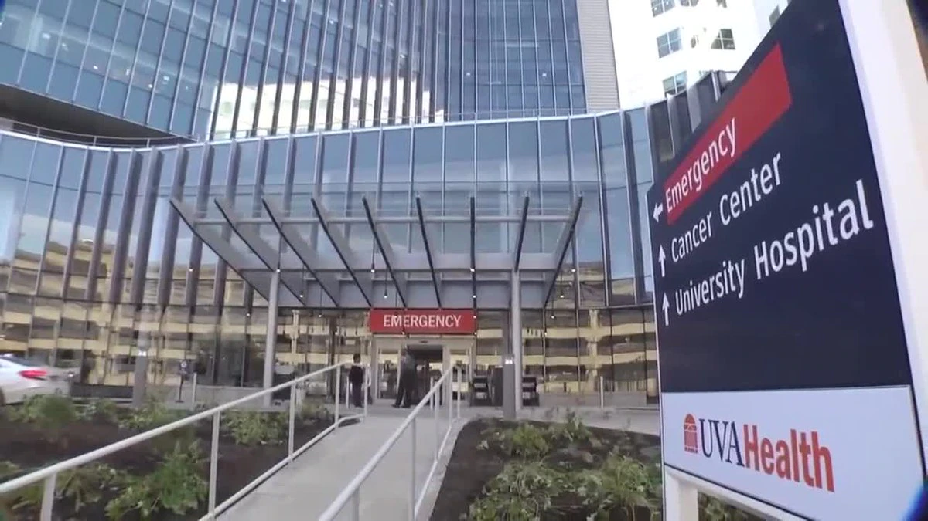
Results: R10 and ED Utilization
R10 utilization prior to arrest decreased odds of ED visit by 54%
p=0.026
Notes:
Testing my hypothesis, I found that subjects with R10 utilization prior to their arrest were nearly 54% less likely to have an ED visit within 12 months, a statistically significant impact. I’d like to pause here to highlight the work of R10 in the significance of this finding. From here, I wanted to look at the utilization of R10 specifically after release from the ACRJ.

Slide 24
Results: R10 and ED Utilization
R10 utilization post-release increased odds of ED visit by three times.
p=0.002
Notes:
Looking at R10 utilization post-release from the ACRJ, subjects were actually 3x more likely to have an ED visit during the 12 months following. My original hypothesis that using R10 services post-release would decrease utilization of the ED assumed that an arrest creates an inflection point of need within a population with a high burden of mental health and substance-use related concerns. I thought that receiving outpatient services at R10 would be able to address this need and therefore decrease the need for higher level care. But what instead may be happening is that the inflection point of arrest signals a high-need population and the period studied following release is not long enough for outpatient services to adequately address these needs in the short-term. I wanted to further explore variables around this “inflection point” to get a better sense of relationships that may exist.

Slide 25
Results: R10 and ED Utilization
No statistically significant relationship between the total number of ED visits within 12 months of release and R10 utilization
No statistically significant relationship between R10 utilization and presenting to the ED with a substance-related diagnosis
Notes:
I found that there was no statistically significant relationship between total number of ED visits and R10 utilization. There was also no statistically significant relationship between R10 utilization and the utilization of the ED for substance-use diagnoses. This further suggests that the period following release is particularly high-need for the jail population, and outpatient services may see more benefit by extending the follow-up window.
I then wanted to see what is what that got people to R10 for services.

Slide 26
Results: R10 and ED Utilization
Subjects who utilized R10 before arrest were nine times more likely to utilize services after release
p<0.001
Subjects were nearly two times more likely to have contact with R10 with each subsequent arrest
p<0.001
Notes:
Those who utilized R10 services prior to arrest were 9x more likely to receive R10 services after release, a statistically significant finding. This means they are going back. They are recognizing the value of the resources at R10 and are continuing to seek care there.
I also found that subjects were 2x more likely to have R10 utilization with each subsequent arrest, and this finding was also statistically significant. This supports the idea of an arrest being an “inflection point” of need, with the nuance of having multiple of these “inflection points” potentially indicating the level of this need, thus increasing the likelihood of connection with R10.

Slide 27
Limitations
UVA Electronic Medical Record is not comprehensive
MRN is not a perfect indicator of whether UVA ED will be utilized
2020 Arrest Data was not included if the booking date was not in 2019
Subsequent arrests during study period may impact utilization of emergency and R10 services
Notes:
There are important limitations to note including that the UVA EMR is not comprehensive because UVA is not the only ED in the area. However, nearly 90% of the original sample had UVA MRNs, so I felt comfortable using this as a proxy for ED utilization.
Also, 2020 arrest data was not included in this analysis if the booking date was not in 2019.

Slide 28
Takeaways
Number of ED visits for recently released individuals is more than 3x that of the general population
Established jail population as having similar high-levels of health needs following release compared to the prison population
Prior engagement with R10 services decreases likelihood of presenting to the ED within 12 months release
12-month period post-release from jail is a high-need time in individual’s lives
Notes:
In summary, this analysis reinforces prior research illustrating the high health needs of the recently incarcerated population. However, the majority of the prior research focused on prison populations, so I would like to especially highlight the importance of this project in not only allowing us to better understand the needs of our own community, but also in illustrating similar research findings within the jail population.
There is much further research needed to better understand the specific health needs of this population.

Slide 29
Next Steps
Notes:
I wanted to end where we started, highlighting that much of this project was aimed at beginning to understand the health care needs of this vulnerable population. I intend to continue my partnership with R10 and ACRJ to work on additional projects using this dataset, in the hopes of filling some of the knowledge gaps.

Slide 30
Future Studies
Potential for further research utilizing this sample
Explore relationship between type of Region 10 services received as well as diagnoses associated with services with ED utilization data
Explore relationship between date of last physical exam, as indicated in the Region 10 dataset with ED utilization data
Potential for further research utilizing larger sample across years
Impact of coronavirus pandemic on ED utilization, R10 utilization, and the relationship between the two
Notes:
I show here some ideas for continued work with this dataset, including expanding the timeframe studied. I am also interested in hearing from you what you think would best address the needs of this population in terms of next steps for research focus.

Slide 31
Acknowledgements
Kristin Wells, PhD MPH UVASOM Department of Public Health Sciences
Peter Alonzi, PhD UVA School of Data Science
Neal Goodloe, MPA Jefferson Area Community Criminal Justice Board
Col. Martin Kumer, ACRJ Superintendent
Neta Davis, Region 10 Senior Director of Child & Family and Adult Clinical Services
Sean Reed, MD and the UVA Generalist Scholars Program

Slide 32
Thank You! Questions?
Contact:
emh7cf@virginia.edu

Slide 33
References
Binswanger IA, Stern MF, Deyo RA, et al. Release from prison—a high risk of death for former inmates. N Engl J Med 2007;356: 157–65.
Cairns C, Kang K, Santo L. National Hospital Ambulatory Medical Care Survey: 2018 emergency department summary tables. U.S. Department of Health and Human Services
Fazel, Seena et al. The health of prisoners. The Lancet, Volume 377, Issue 9769, 956 - 965
Frank et al.: Emergency department utilization among recently released prisoners: a retrospective cohort study. BMC Emergency Medicine 2013 13:16.

Slide 34
Statistical Results
Impact of Region 10 services pre-arrest on ED utilization
OR: -0.54; p=0.026
Impact of Region 10 services post-release on ED utilization
OR: 3.095; p=0.02
Impact of Region 10 utilization pre-arrest on post-release utilization
OR: 9.01; p<0.001
Relationship between total number of ED visits and R10 utilization
OR: 1.094; p=0.263
Relationship between increasing number of arrests and R10 utilization
OR: 1.987; p<0.001
Relationship between R10 utilization after release and presenting to ED with substance-use related diagnosis
OR: 2.412; p=.127

Slide 35
Results—Region 10 Utilization
Notes:
I classified the Region 10 utilization data in two ways, the first showing utilization of services during the entire FY 2019-2021 period. The chart here is showing the rates of this R10 utilization for individuals based on whether they had a substance-related arrest type. As you can see, there is little difference between the utilization between these groups. However, 40% utilization is an impressive number and is suggesting that this is a population that not only has high need for R10 services, but is seeking those services.
Combine pre and post release utilization as the 2 bars in the graph (before the 2 stats slides?)

Slide 36
Results—Region 10 Utilization
Notes:
As you can see in this table, the utilization of R10 services is about half that over the overall utilization seen previoulsy. Interestingly, this shows the similar finding that rates of R10 utilization are near equal for those with or without a substance-related arrest. I am not suggesting that lack of a substance-related arrest means an individual may not benefit from services at R10, but instead that presence of a substance-related arrest suggests that their likelihood of benefitting from R10 services may be higher.

Slide 37
Results—Region 10 Utilization
Notes:
I classified the Region 10 utilization data in two ways. The first, shown here, is if a subject had any contact with R10 during the entire period of FY 2019-2021. This was done to capture if an individual had engagement with R10 prior to their arrest and subsequent release. The chart here is showing the rates of this R10 utilization for both individuals with any arrest type as well as for individuals with an arrest type classified as substance-related. As you can see, there is little difference between the utilization between the whole sample and this subset.

Slide 38
Results—Region 10 Utilization
Notes:
The second way the R10 utilization was classified was on if it occurred within the 12 months post-release from the ACRJ. Again, I show the differences in utilization between those with any arrest type and those with substance-related arrest types. You see little difference between the two. Lack of a substance-related arrest does not mean an individual may not benefit from services at R10, but presence of a substance-related arrest suggests that they may, indicating a possibility for further engagement.

Slide 39
Ineligible Release Reasons
Confinement Change within Facility
Furlough
Serve Sentence in Department of Juvenile Justice
To Department of Corrections
To Another Jail
To State Hospital
Serving Weekend Sentence
To Comprehensive Community Corrections Act Program
To Detention Center
To Diversion Center
To Hospital (Emergency)
To Treatment Facility
To Federal Authority
To Out-of-State Authority
To Military Authority
Died of Natural Causes
Died of Unnatural Causes
Immigration Detained/Removed

